Slide 1
Wokeness and Big Tech
Peter G. Klein
Mises University
2023
@petergklein
#MisesU

Slide 2
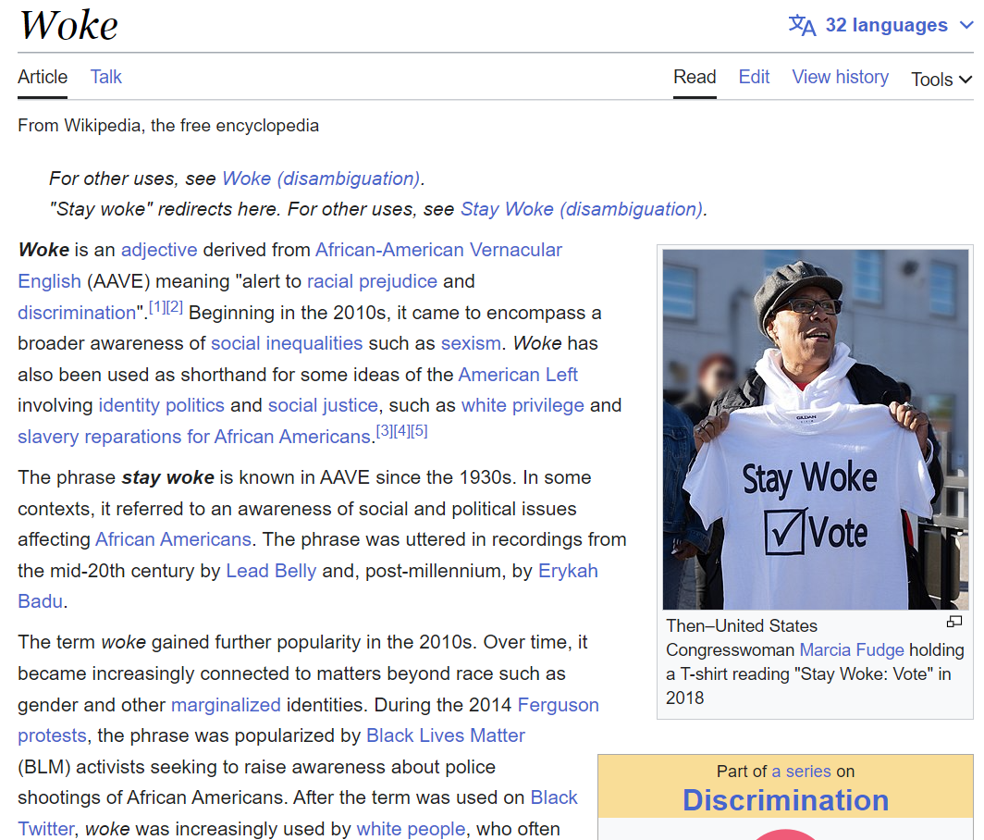



Slide 3
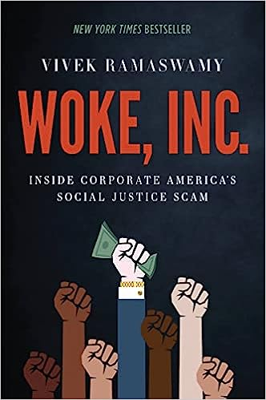






Slide 4
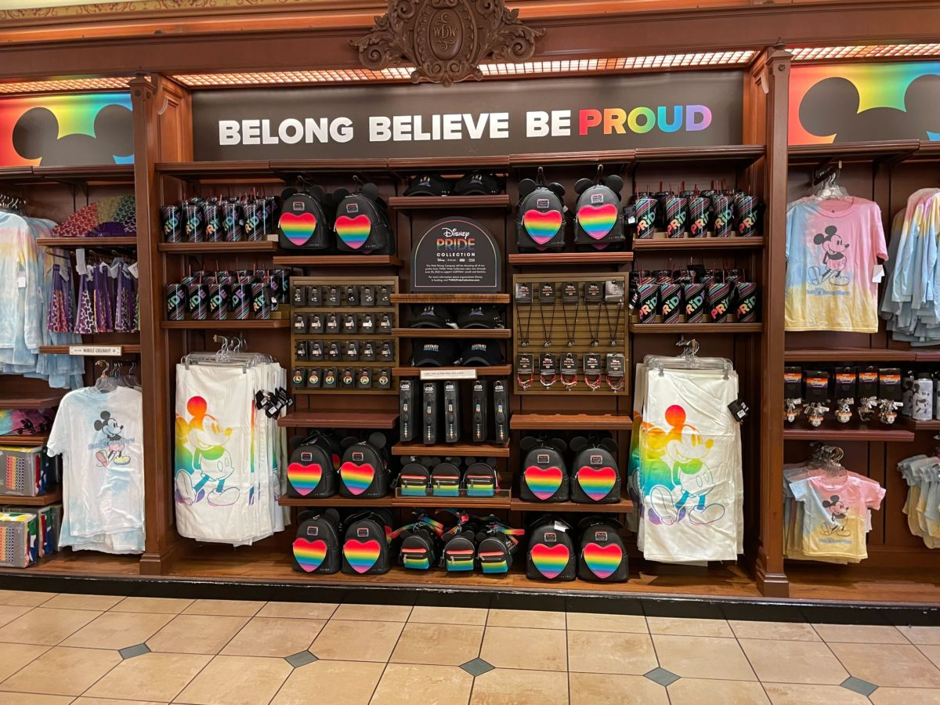




Slide 5

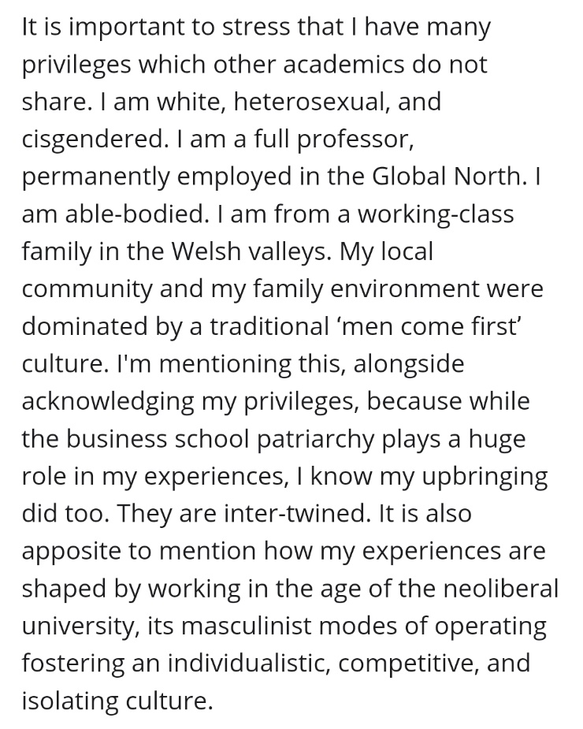
Wokeness
Primary concern with “social justice,” especially related to race, gender, sexual orientation, and sexual identity
Philosophical origins in Frankfurt School + French postmodernist thought (critical theory)
  Primacy of subjective, personal experience over logical argument, data (“speak your truth”)
  Polylogism / truth as positional
  Emphasis on group characteristics and social structures rather than individual behavior, responsibility (“structural racism,” “patriarchy,” “intersectionality”)
  Oppressor/victim dynamic (“cultural Marxism”) (“check your privilege”)
Whig theory of history (“right side of history”)

Slide 6
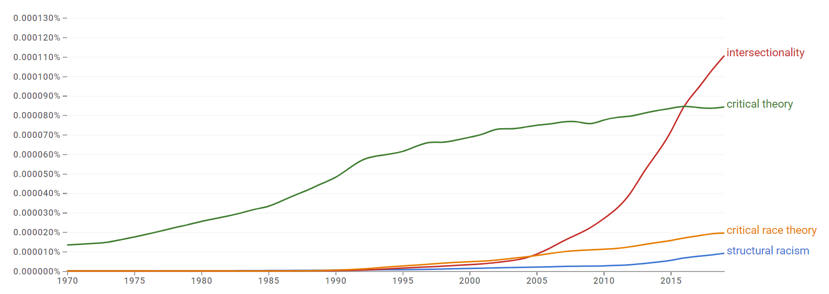

Slide 7
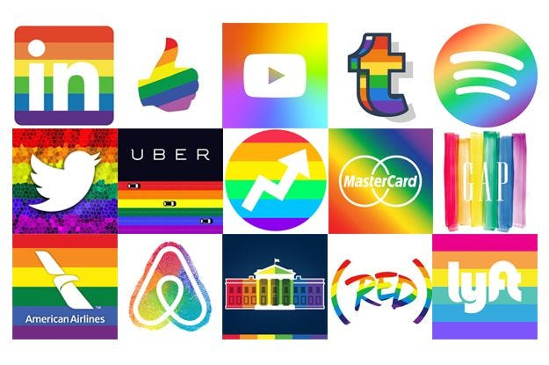
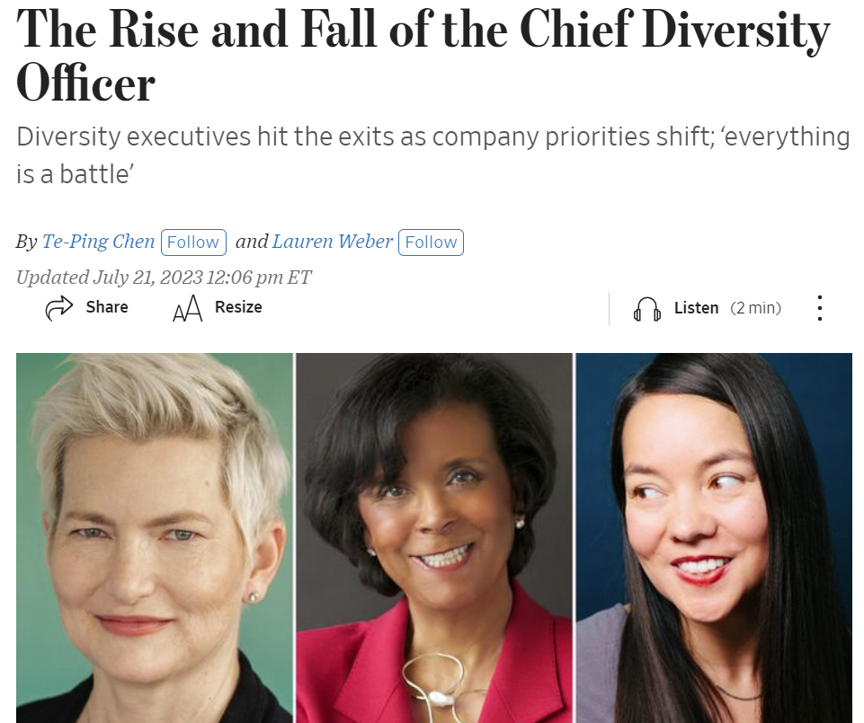
Wokeness in companies, universities
Probably not driven primarily by ideology
Instrumental motives
  Appeal to woke customers, investors, employees (faculty, students, donors)
  Attempts to curry favor with woke regulators, judges
  Pressure from external parties (institutional investors, ratings agencies)
  Fear of negative publicity
Results
  Explosion in DEI programs – now seeing pushback
  Marketing and public relations
  Philanthropy, lobbying
Additional driver: entrenched middle managers
Nicolai J. Foss and Peter G. Klein, “Why Do Companies Go Woke?” Academy of Management Perspectives, forthcoming.
Nicolai J. Foss and Peter G. Klein, “Strategy Under Woke Capitalism,” in Marcus Larsen, Michael Leiblein, and Jeffrey Reuer, eds., Strategy in a Turbulent Era (Edward Elgar, forthcoming).

Slide 8
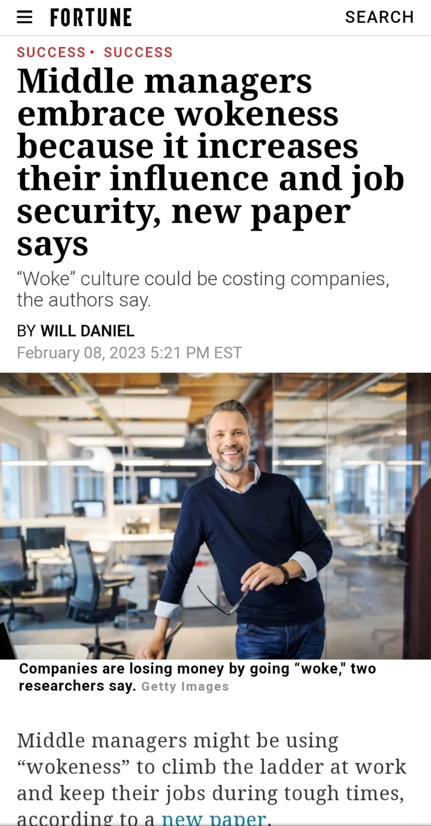
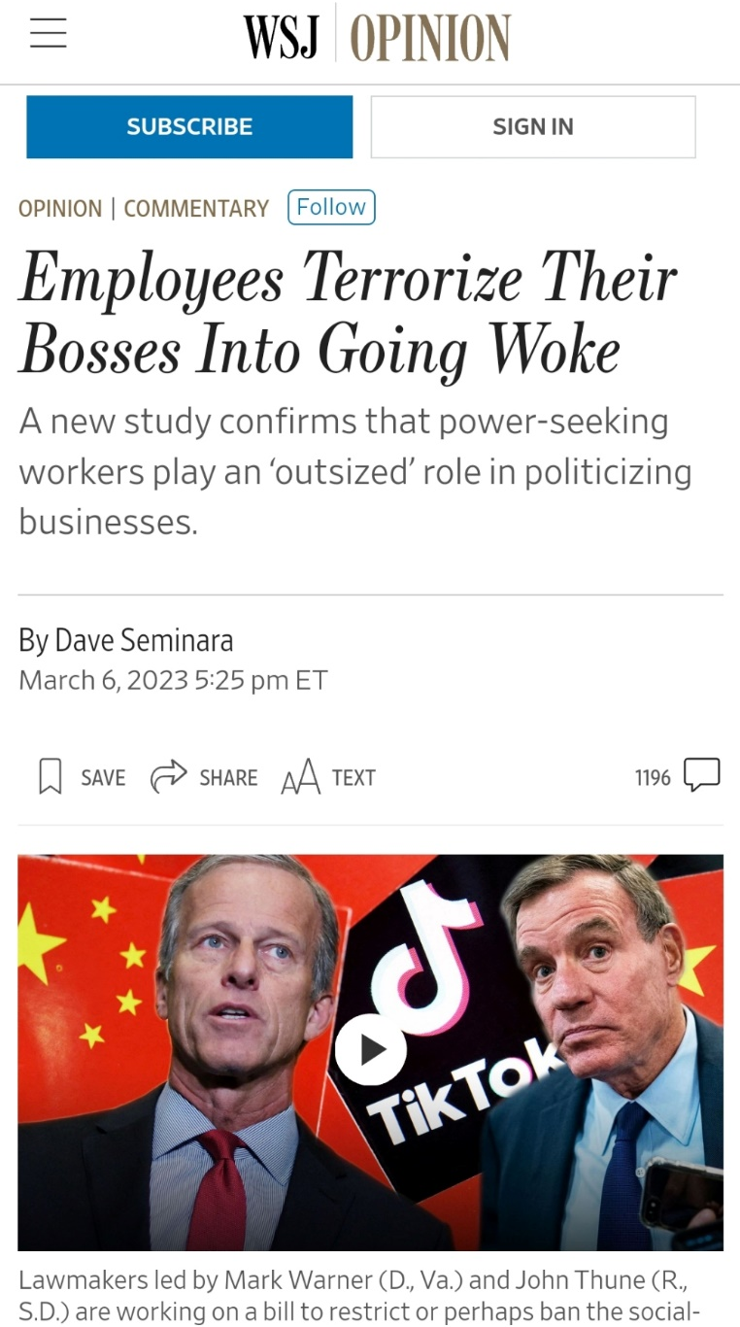
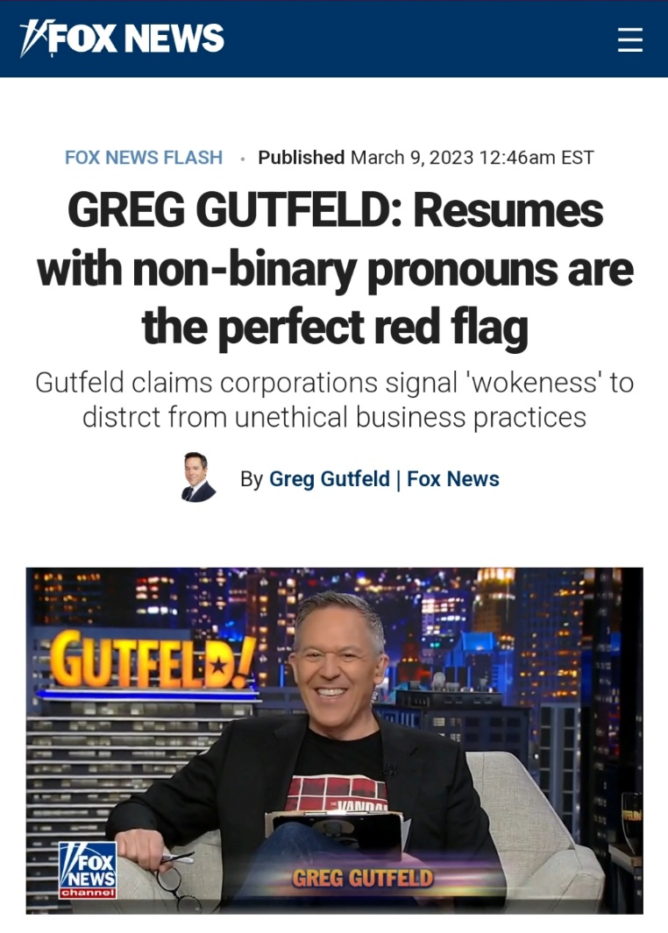
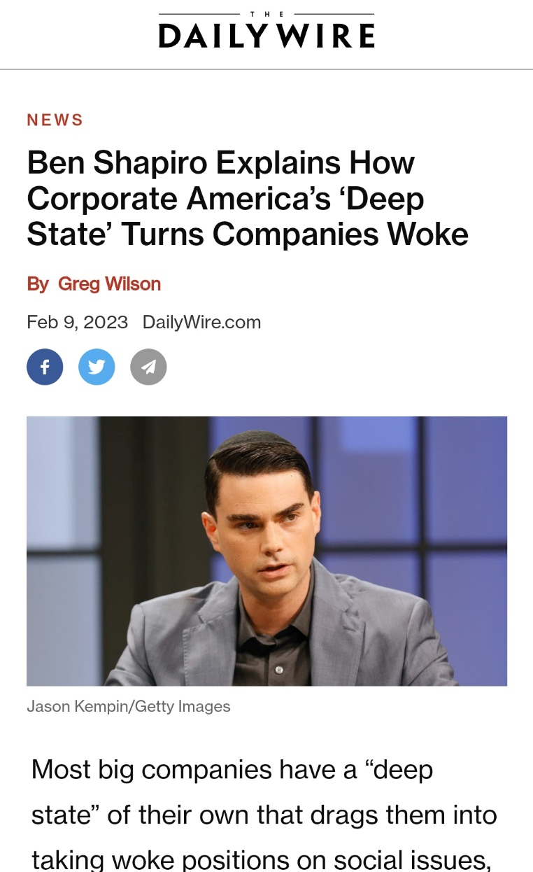
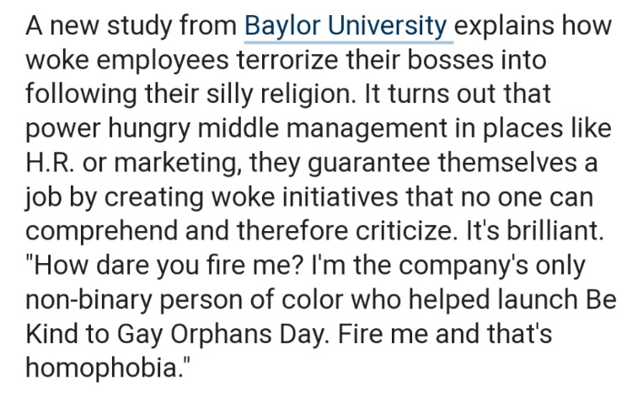

Slide 9
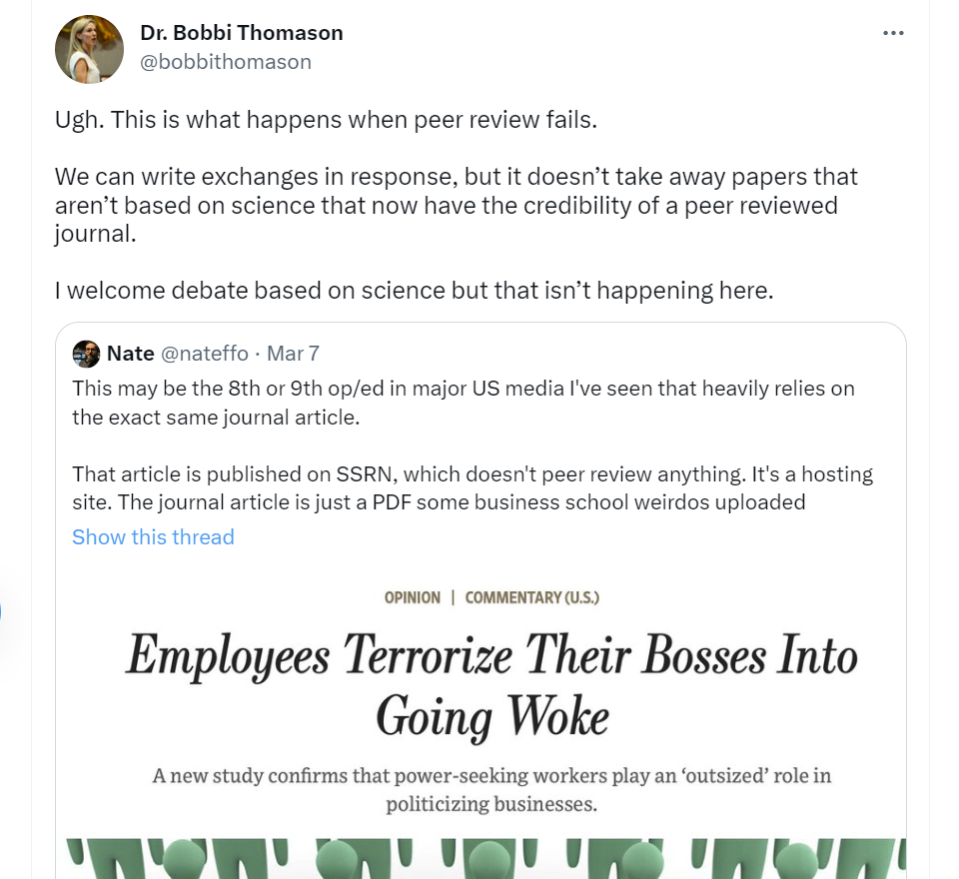

Slide 10
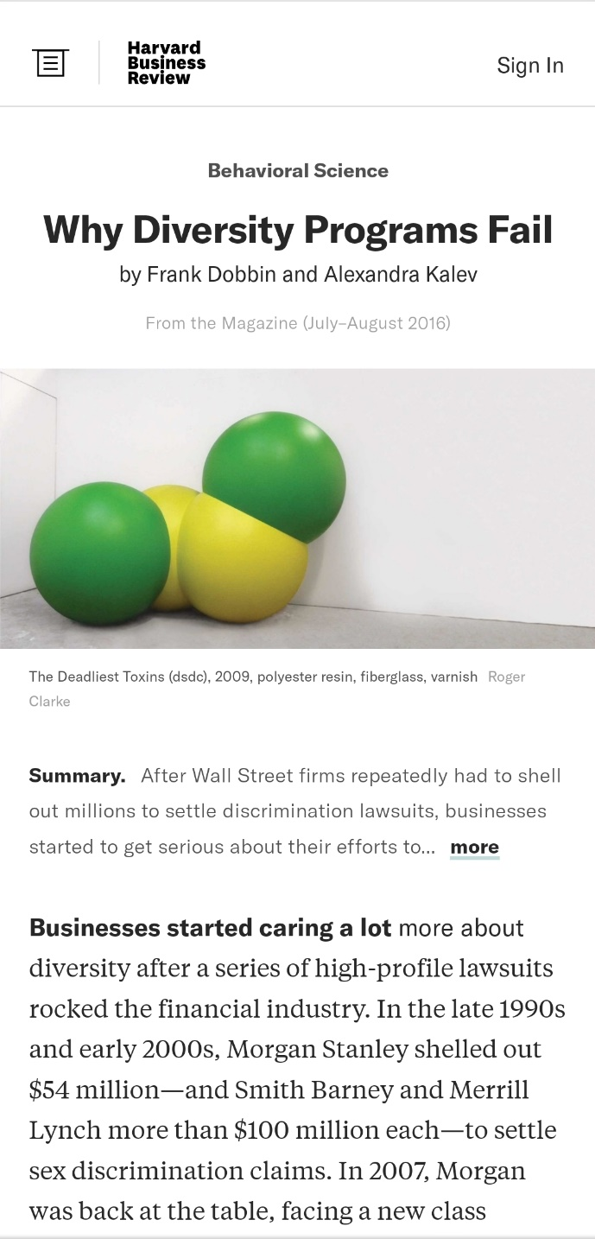
Wokeness as a source of managerial entrenchment
No evidence that owners, boards, top executives are woke
Employees generally ignore DEI programs
  If anything, attitudes toward diversity get slightly worse (many studies)
Key beneficiaries mostly middle managers
  Top executives need plausible deniability, regulatory protection
  DEI programs largely run by HR, marketing departments
  Obscure, specialized vocabulary facilitates entrenchment
    Equity, antiracism, fragility
    Cis, BIPOC, BAME, URM, Latinx, Phillipinx
    Intersectionality, performativity, heteronormative
    Deadname
    Microaggression

Slide 11

Wokeness and big tech 1/
Empirical puzzle: wokeness appears to cluster by industry
  Entertainment, journalism, education, finance, tech
  But not manufacturing, energy, transportation, many services
Possible explanations
  Ability to sustain nonproductive employees
  Higher regulatory burden
  Employee/manager/investor self-selection?

Slide 12
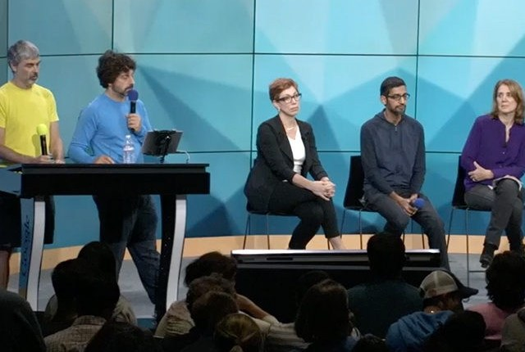
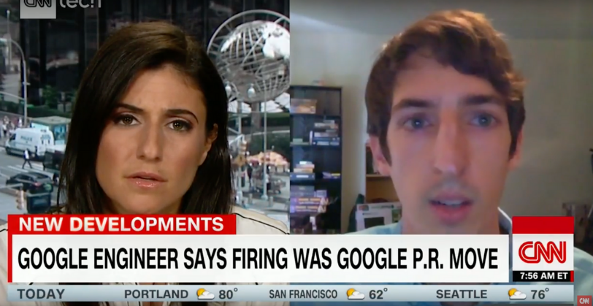
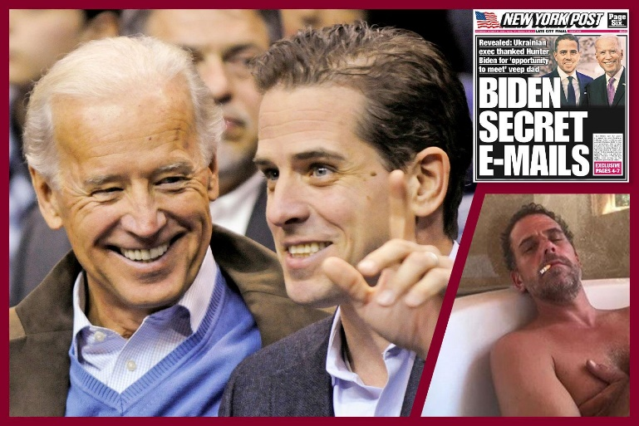
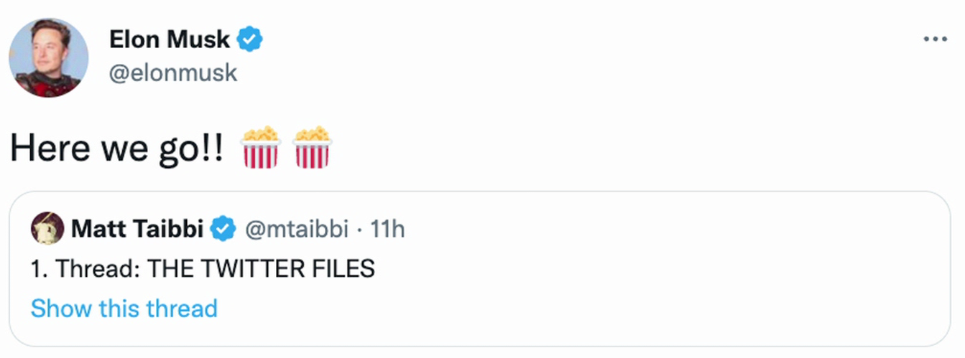
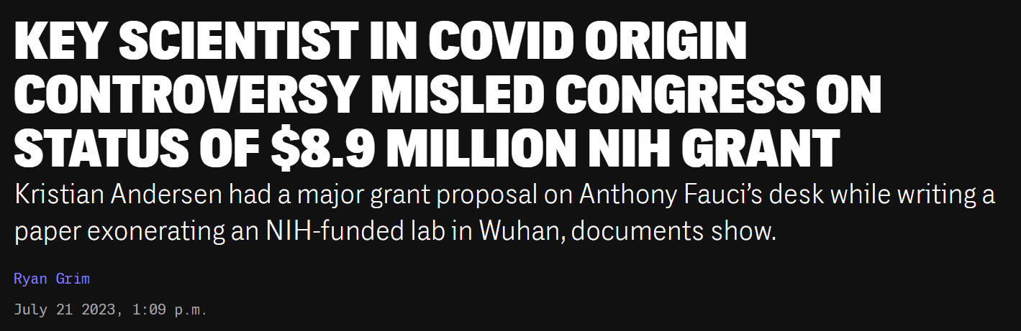
Wokeness and big tech 2/
Tech firms as victims of wokeness
  Government pressure
  Desire to please woke employees
  Delegation to middle managers
Tech firms as drivers of wokeness
  Netflix, Amazon, Disney, other content providers and distributors
  Social media, retailers, exchanges: deplatforming, suppressing politically inconvenient material, spreading misinformation, working with government officials

Slide 13
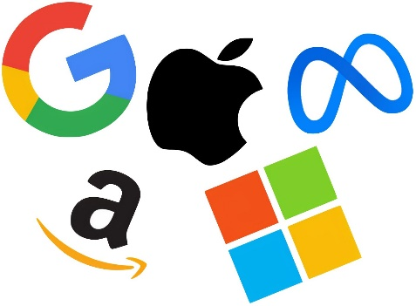
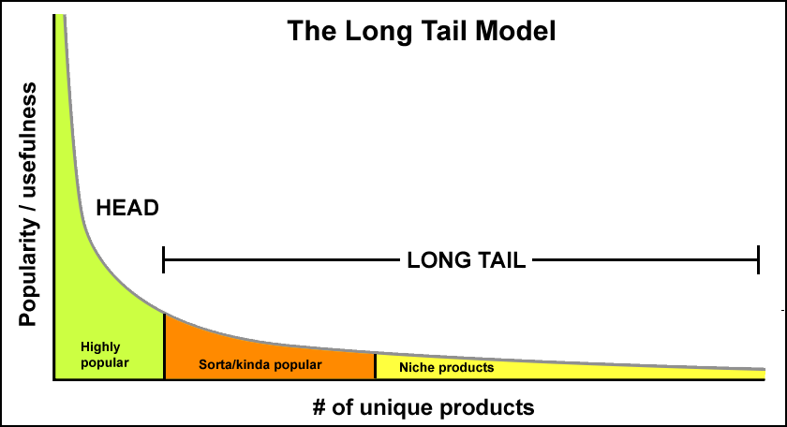
Why (some) tech companies, like universities, are woke
Business models and primary revenue streams
Low costs of wokeness on the periphery
Analogy with book publishing
The case of academia

Slide 14
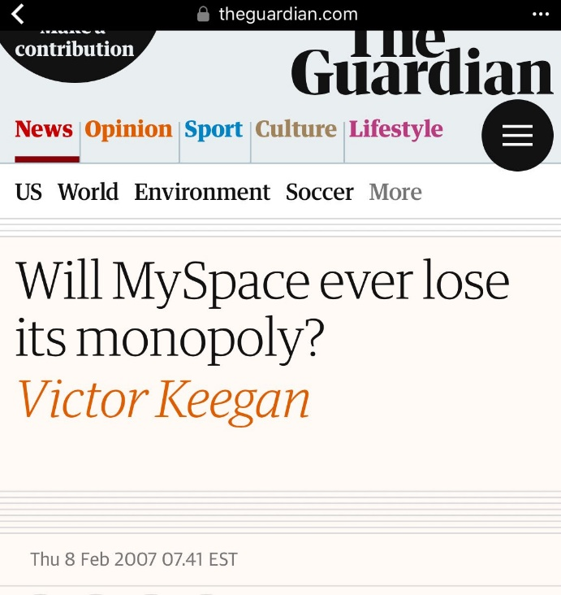









Do woke tech firms have monopoly power?
Large market shares (sometimes)
  Network effects
  Large fixed costs, low marginal costs, leading to first-mover advantages (winner-take-most markets)
  Ability to profit from ecosystem
  spillovers, platform ownership
But still competition, absent
government protection

Slide 15

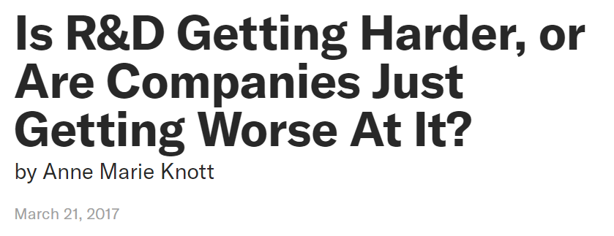
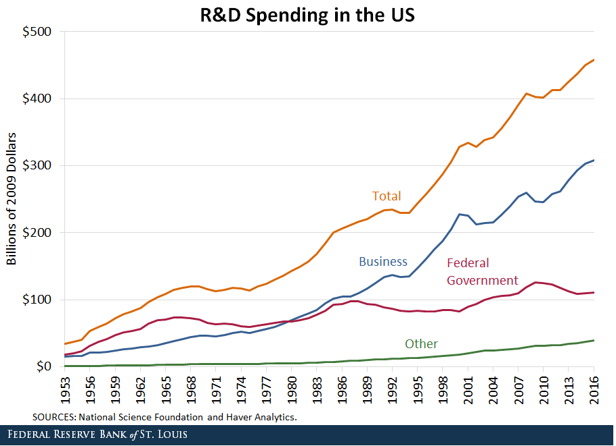
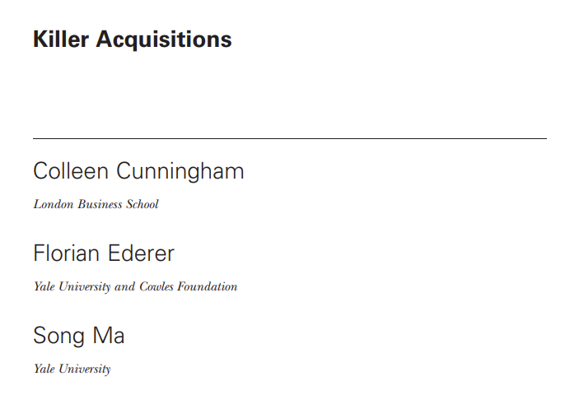


Do tech firms suppress innovation?
Corporate R&D
  Schumpeter on firm size and innovation
  Rise of science-based discovery
  Decline in returns to corporate R&D?
  Mazzucato and capitalist myopia?
Killer acquisitions
  Problem of counterfactuals
  Owner sovereignty and entrepreneurial judgment

Slide 16
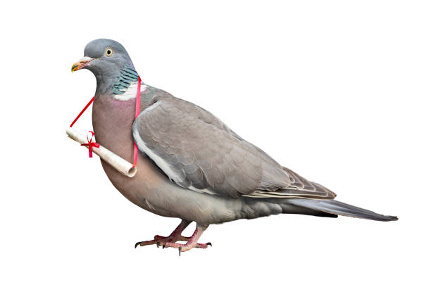

Policy toward big tech
Breakups, public ownership
Regulation
  Content neutrality (common-carrier status, the “public square,” etc.) to reduce woke bias
  Bans on private-label placement
  Mandatory data portability, bans on collecting user data (would then need alternative pricing models)
  Note on privacy
    In some ways, platforms create more privacy
    We can pay (in $$$ or inconvenience, reduced
    usability) for more privacy, yet very few do
Remove all privileges, protection
  Sec 230, CDA

