Slide 1
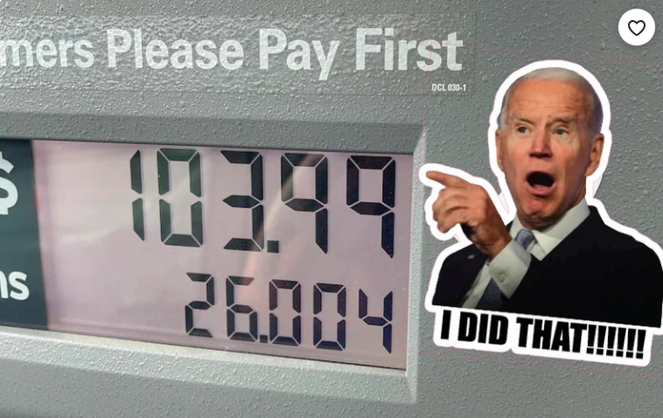
PRICE INFLATION:
QE vs. COVID
Robert P. Murphy
Mises University 2022

Slide 2
OUTLINE
A) QE didn't lead to high CPI inflation, Covid did
B) Popular explanations (and their problems)
C) M1 and M2 behaved differently

Slide 3
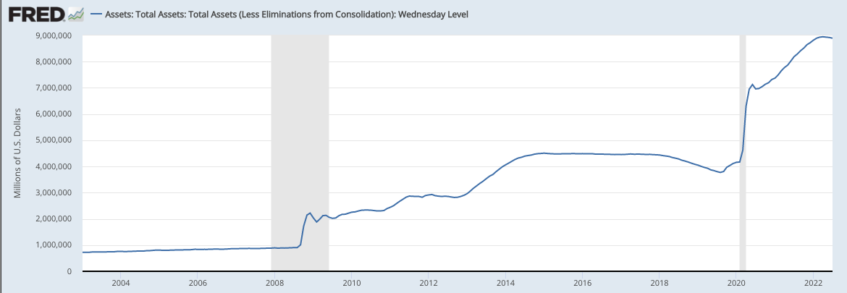
Federal Reserve's Asset Purchases
Covid
QE 3
QE 2
QE 1

Slide 4
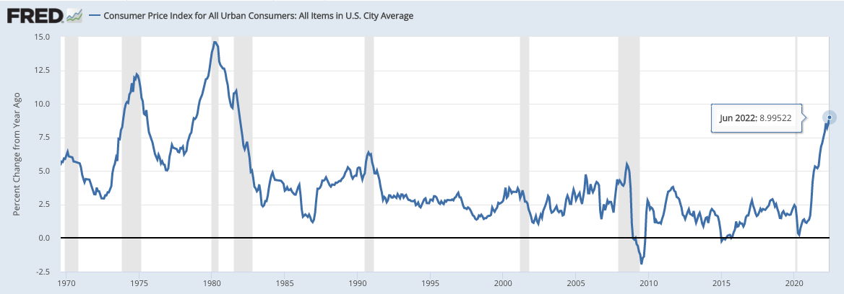
12-month Growth in
Consumer Price Index (CPI)

Slide 5
WHY DIDN'T QE LEAD TO LARGE CONSUMER PRICE INFLATION?

Slide 6
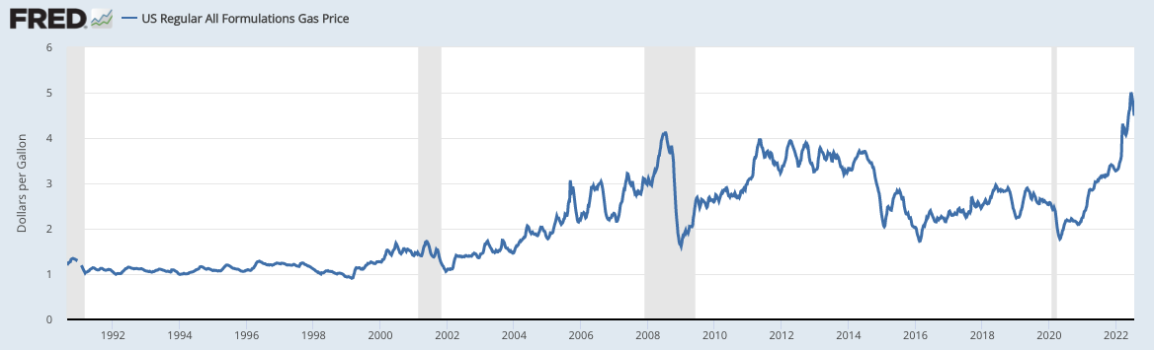
Popular Explanations:
➔ "They use tricks to hide the true (consumer price) inflation rate."
But contrast with the counterfactual!

Slide 7
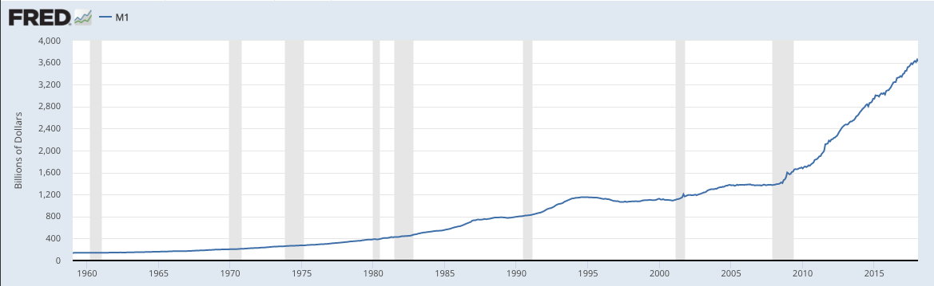
Popular Explanations:
➔ "Banks didn't lend out the new money; it sat bottled up in reserves."

Slide 8


Popular Explanations:
➔ "The new Fed money went into the stock market, not consumer goods."
$1000 in checking
accountext
10 stock shares market value $80 eachext
10 stock shares market value $100 eachext
$1000 in checking
accountext

Slide 9
M1 vs. M2
➔ M1 (pre-2020) defined as currency in hands of the public, plus demand deposits (checking account balances), and some other very liquid items.
➔ M2 defined as M1 plus some other items such as Retail Money Market Mutual Funds (MMMFs).

Slide 10
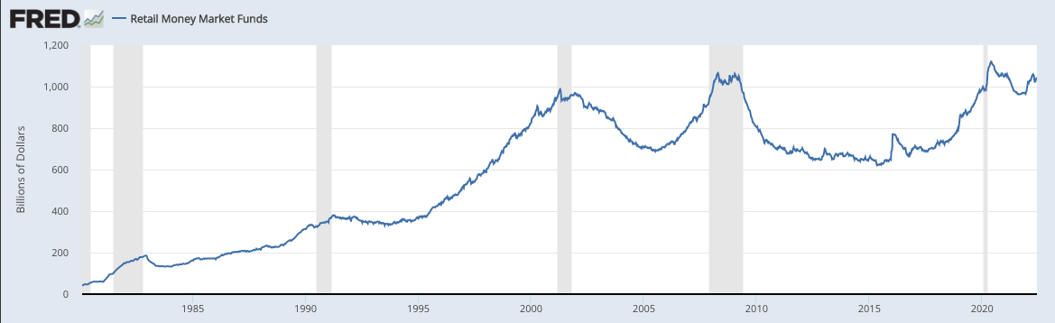
Retail MMMFs Then vs. Now:

Slide 11
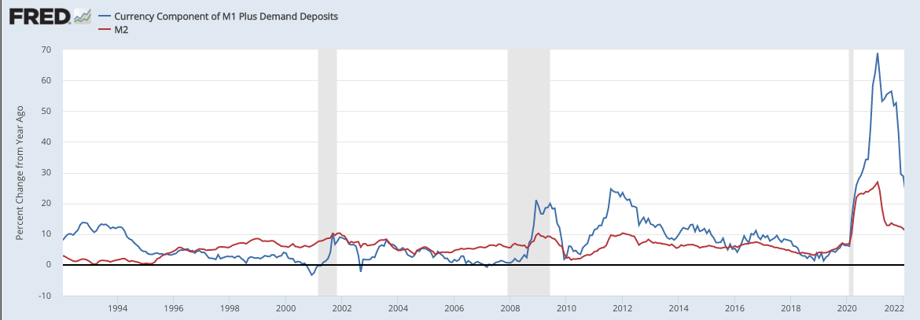
Growth Rates in M1 & M2,
QE vs. Covid:

