Slide 1

The Fallacies of
Market Monetarism
Robert P. Murphy
Mises University 2022

Slide 2
OUTLINE
A) Original Monetarists (Friedman) on Low Interest Rates Misleading during Great Depression and Japan slump
B) Sumner: NGDP Growth Better Measure of Money Being "Tight" or "Easy"
C) Sumner: Use Market Forecasts Not "Experts"
D) Problems with Market Monetarism

Slide 3

Milton Friedman: Low Interest Rates
Didn't Mean "Easy Money" during Great Depression & Japanese "Lost Decade"

Slide 4

Scott Sumner: Low Interest Rates AND High Money Growth Are Poor Indicators of "Tight" or "Loose" Fed; Look to NGDP Growth Instead

Slide 5
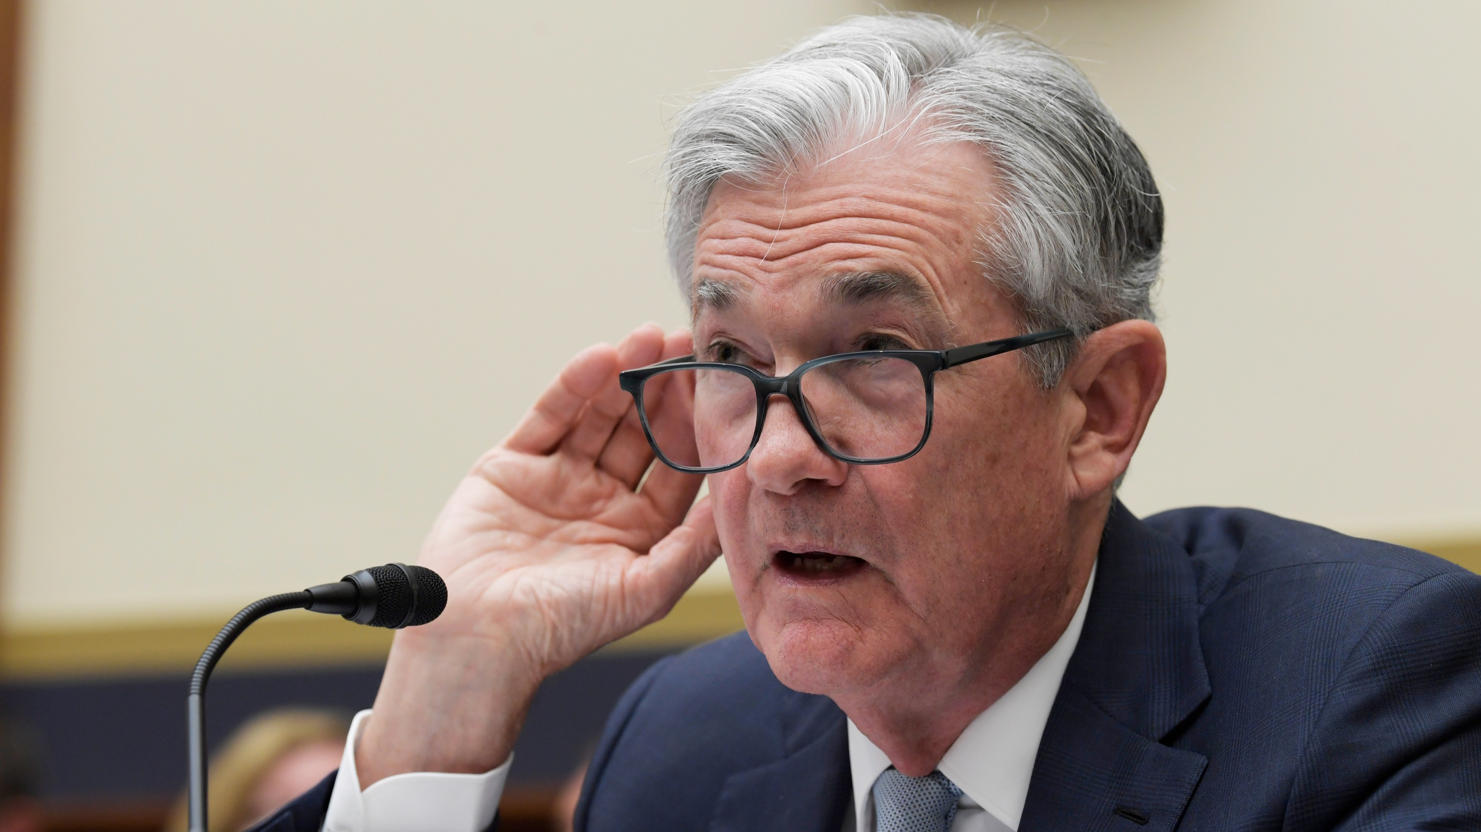
Scott Sumner: No Need for Central Bank "Experts"; Use Markets to Set Expected NGDP Growth Equal to Fed Target

Slide 6

Scott Sumner: Great Recession Occurred Because Bernanke's Fed Was TOO TIGHT (!!)

Slide 7
Problems With Market Monetarism
➔ Unlike F&S on Depression, money growth increased after 2008 crisis
➔ Fans often conflate NGDP with "total spending"
➔ Criterion of NGDP growth vacuous and almost non-falsifiable (medical analogy)
➔ Ignores capital structure (and Austrian Biz Cycle Theory)

