Slide 1
Competition and Monopoly
Peter G. Klein
Mises University
2023
@petergklein
#MisesU

Slide 2
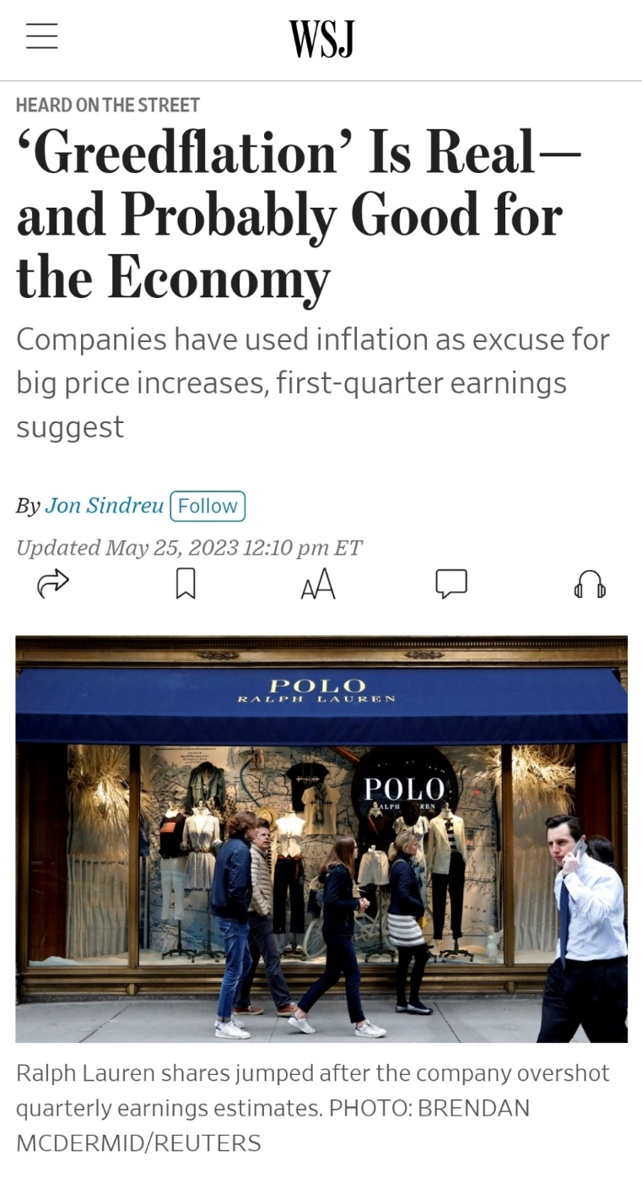
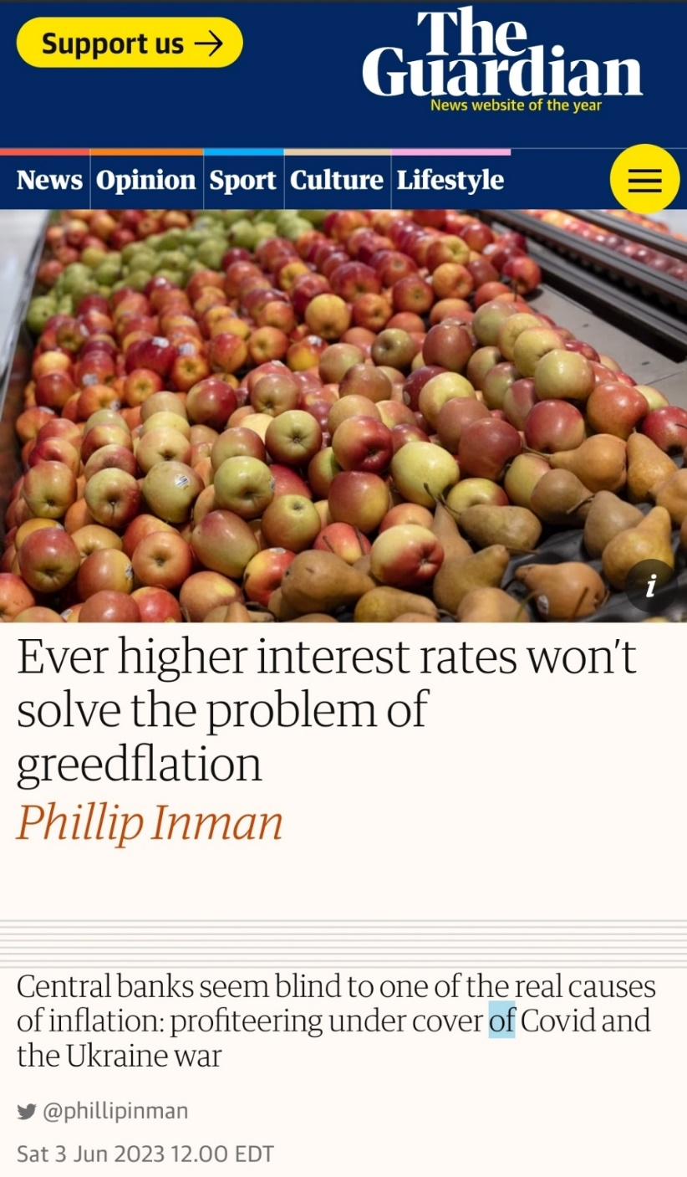
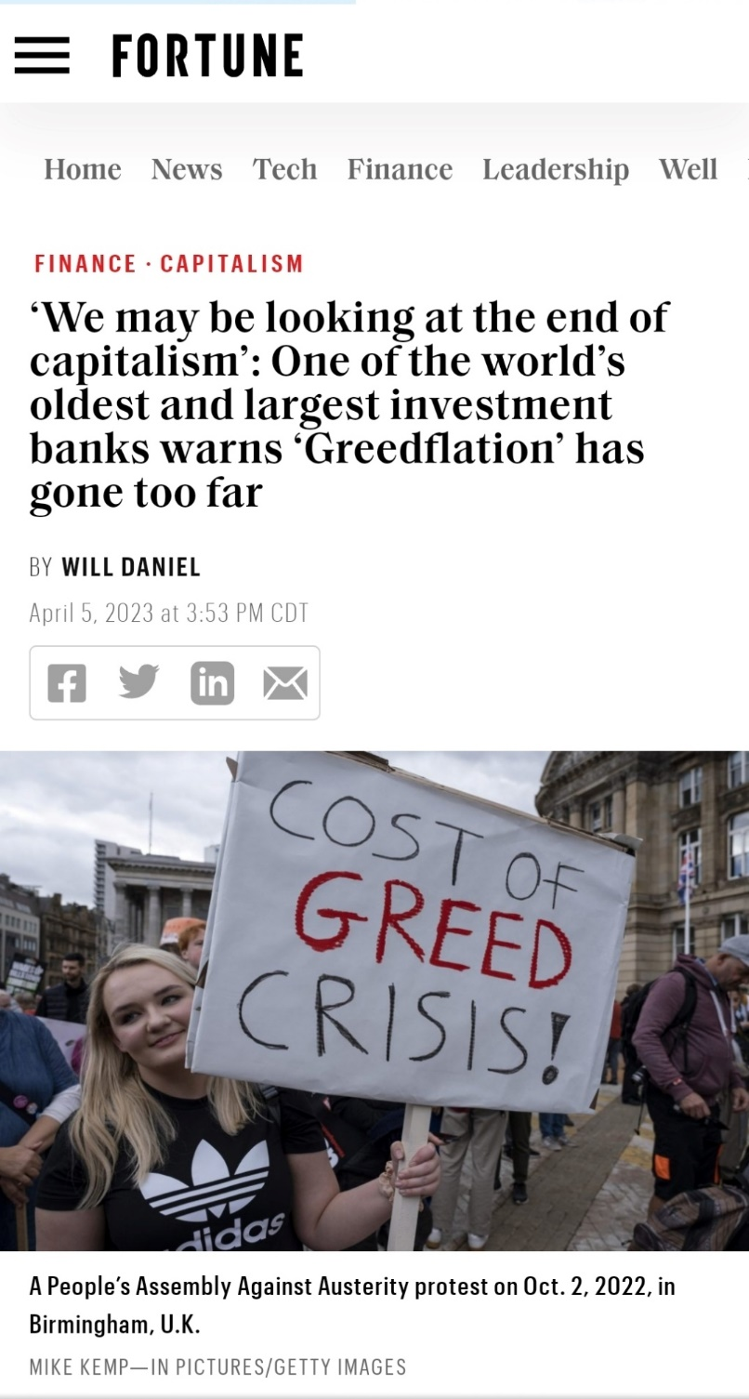
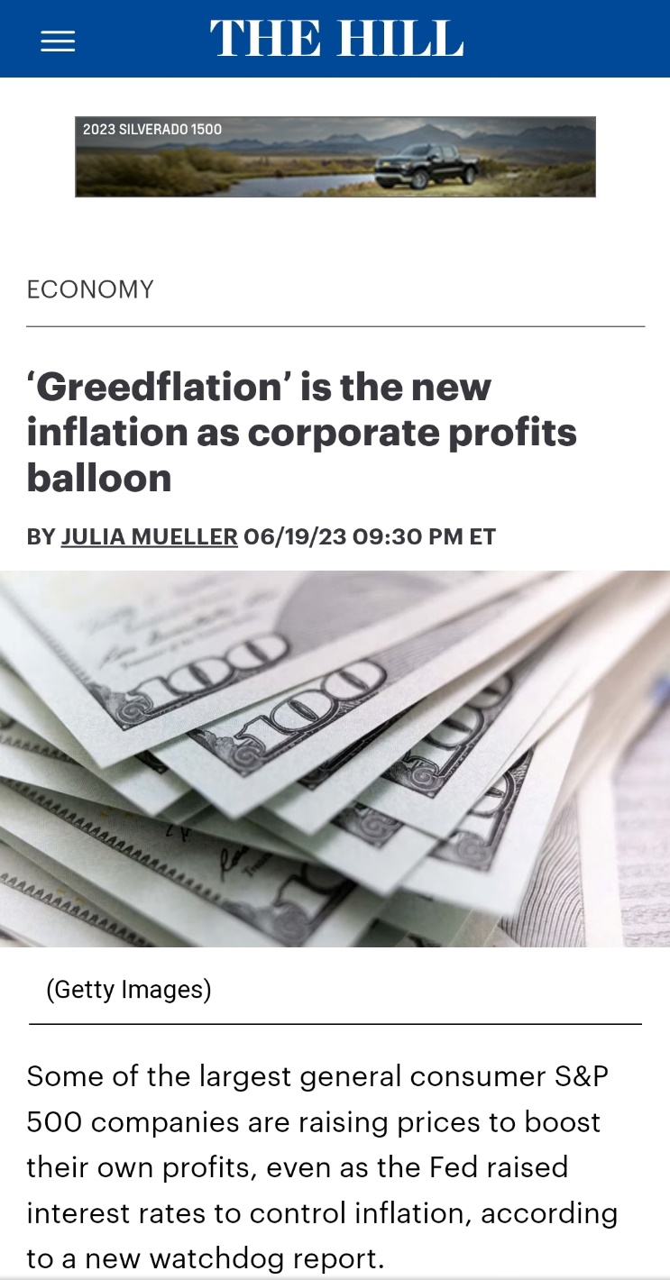
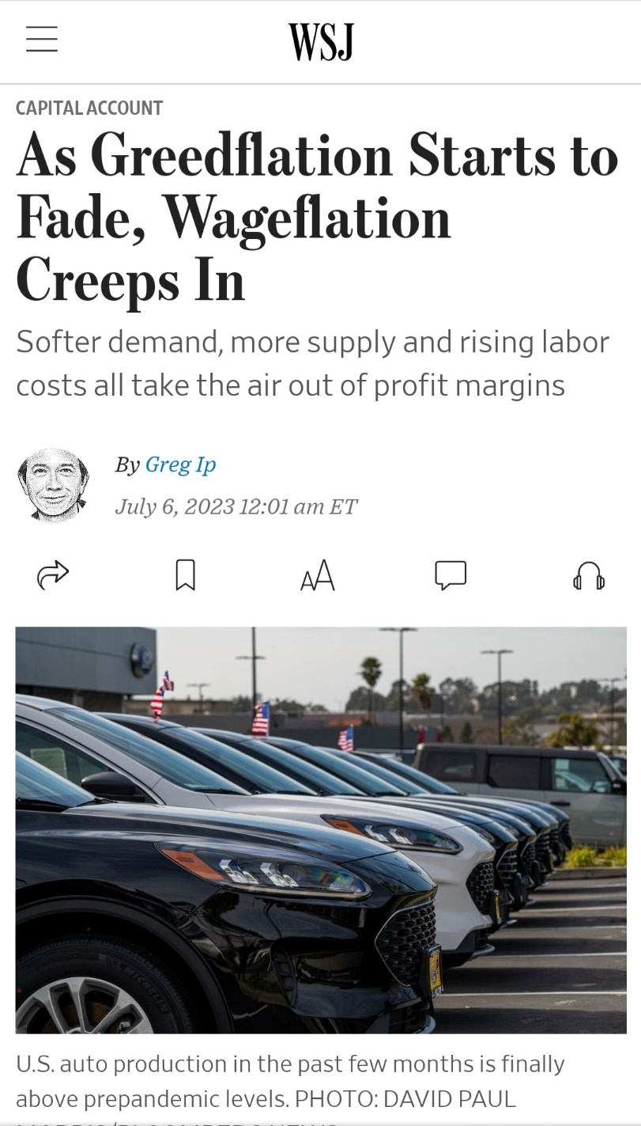

Slide 3
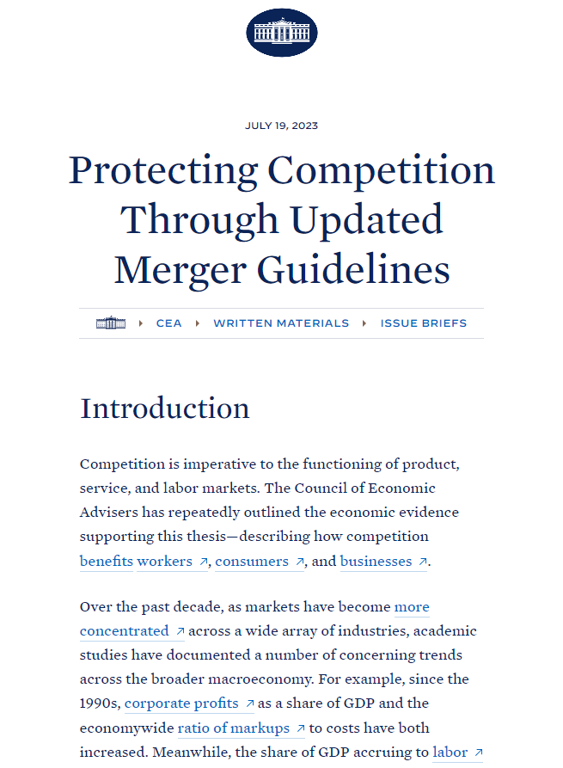
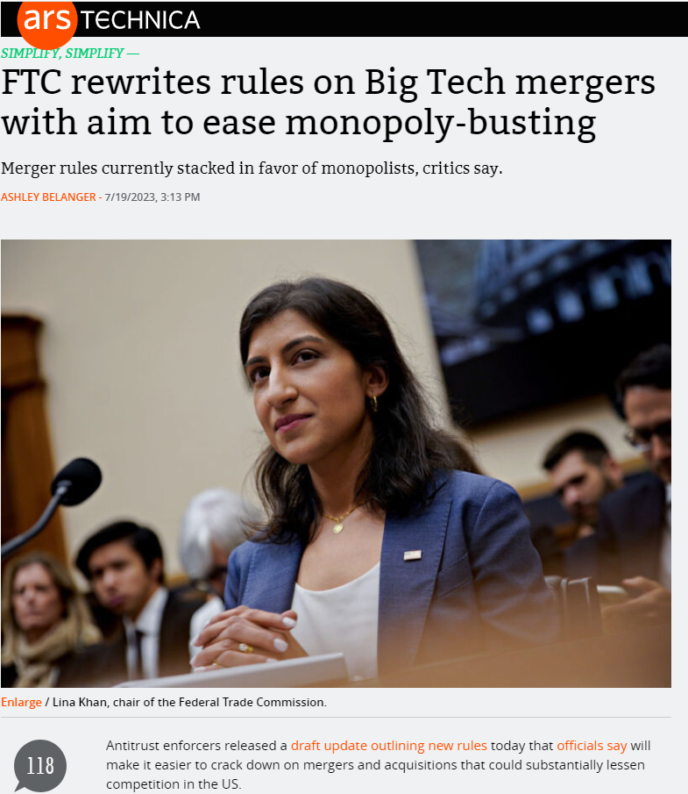

Slide 4

What is “monopoly”?
Mainstream economics
  Firm with market share above X percent (where X = magic number to make the firm in question a “monopolist”)
  Ability to raise price above marginal cost
  Firm earning positive economic profits
Common-law, classical definition
  Exclusive legal privilege to produce
  or sell a product, enter a market
Austrian economics
  Some differences of opinion

Slide 5

Monopoly as the absence of competition
“Competition” in everyday language
  Effort to beat rivals at some task (a “competition” at school, sports)
  A particularly intense competition (a “highly competitive” exam, process, contest)
Competition in economics
  Neoclassical constructs of “perfect” and “imperfect” competition
  Austrian approaches to monopoly

Slide 6
The perfectly competitive firm
P
Demand curve (= MR curve) assumed to be perfectly elastic.
Firm maximizes profit by producing the quantity at which MR = MC.
Long-run: entry and exit drive market price to the minimum of average cost and zero profits (“good” outcome).
MC
AC
P_{PC}
D = MR
Q
Q_{PC}

Slide 7
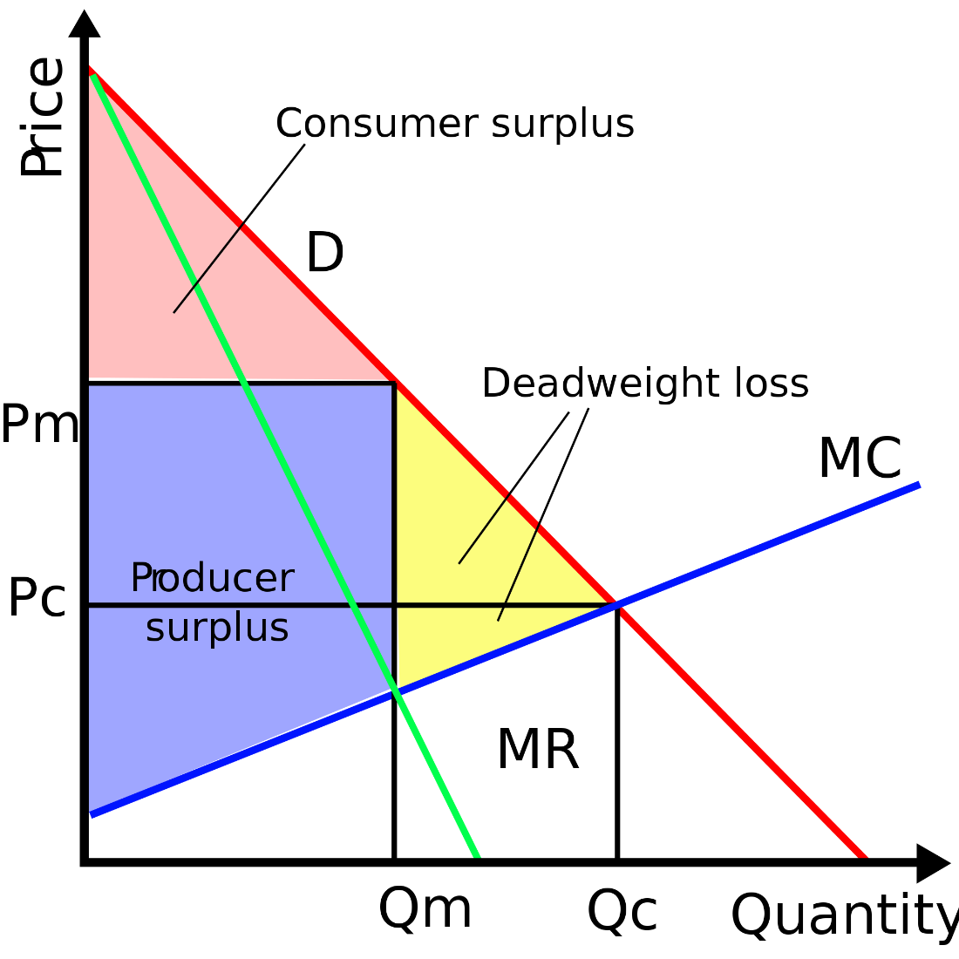
The firm with “market power”
“Market power” = downward-sloping demand curve.
Firm maximizes profit by producing the quantity at which MR = MC (and hence p > MC)
Firm “restricts” output to increase profit (assuming demand curve is inelastic above the “competitive” price), generating monopoly profits (bad outcome).

Slide 8
Austrian critiques of the market-power approach
Each seller contributes a discrete quantity to the market supply, so no such thing as perfectly elastic market demand curve.
  No infinitesimally small units in the world of purposeful human action (Rothbard)
Requiring firms to increase output beyond the profit-maximizing quantity violates owners’ property rights, lowering social welfare.
  Movie-star example
  Hutt (1939), Rothbard (1962): resources not currently used in production are not “idle,” especially when they can be invested in other firms or industries!
Elasticity of demand reflects consumer preferences.
  Existence of close substitutes is an economic, not a technological, concept!

Slide 9

Mises on monopoly prices
Monopoly prices emerge only under special conditions.
  Single seller of a unique good (or sellers’ cartel)
  Inelastic demand above the competitive price (the price that would otherwise have obtained)
Monopoly prices do violate consumer sovereignty.
  But the conditions giving rise to monopoly prices are rare, and not usually relevant for policy.

Slide 10
Rothbard’s refinement of Mises’s monopoly theory
All sellers face a downward-sloping demand curve.
No way to distinguish a “monopoly” from a “competitive” price, in the absence of legal restrictions.
  All firms try to maximize net income given their estimates of demand.
  All firms price in the elastic range of their demand curve (and elasticity is the result of consumer preference, i.e., voluntary).
Government-granted monopoly
  Patents
  Exclusive grants, charters, licenses
  Tariffs and quotas

Slide 11

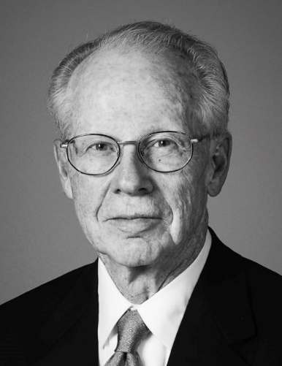
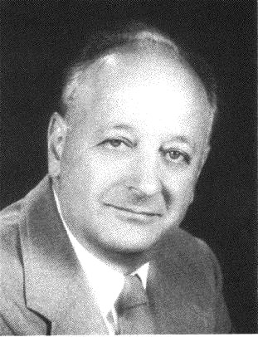

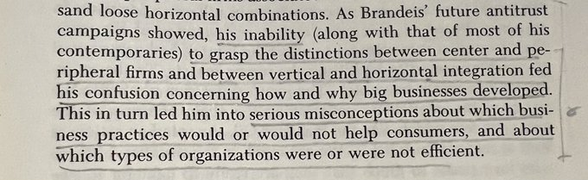
Antitrust and competition policy
The structure, conduct, performance (SCP) paradigm (emphasis on firm size and market concentration)
Oliver Williamson on vertical integration
The Chicago and UCLA schools
Hipster / neo-Brandeisian antitrust
  SCP idea that big is necessarily bad
  Attack on the consumer welfare standard

Slide 12
Summary
Competition is a process of rivalry among entrepreneurs who are free to compete as they see fit, within a given legal framework.
  Few firms or many firms
  Large firms or small firms
  Profits and losses
  Entry, exit, growth, innovation, experimentation
Government attempts to limit “monopoly power” cannot improve well-being.
  Best government policy: don’t grant monopoly privilege!

