Slide 1
The Political Economy of Policing
Tate Fegley
Mises University 2023

Slide 2
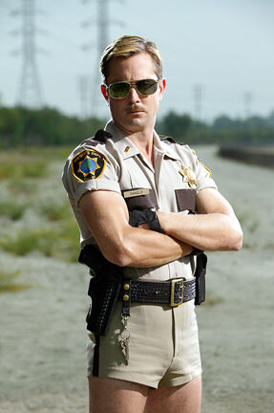
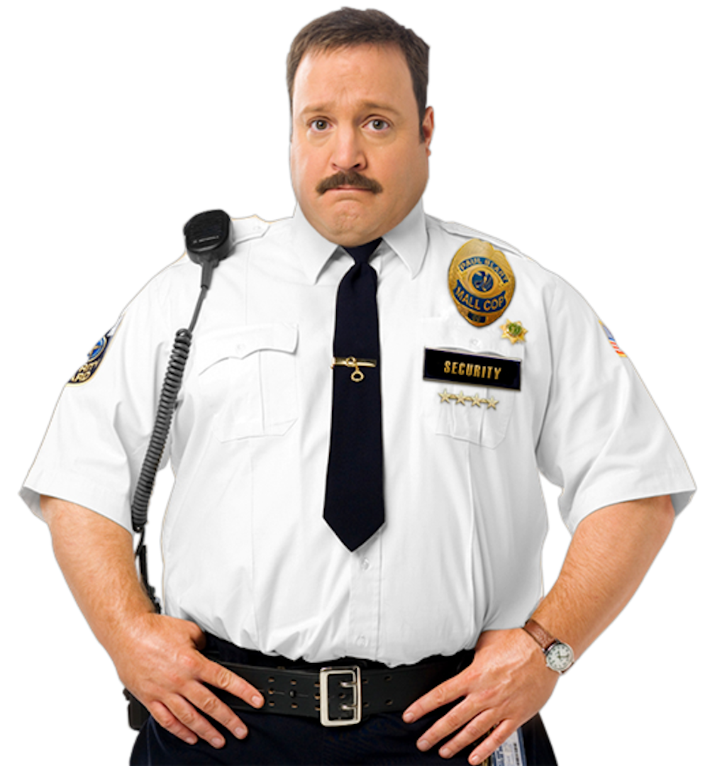
What is it?
The “political economy” part is the economic analysis of the institutions through which policing is provided.
“Policing” can refer to the activities that state police officers perform, as well as the the enforcement of property rights and protection of persons regardless of whether these services are provided by state actors or private individuals.

Slide 3

The key is economic calculation
Government police departments are run bureaucratically – they rely on involuntary payments (taxation) for revenue and their output is disconnected from consumer sovereignty.
Private security bought voluntarily in the market, by contrast, is subject to profit and loss calculation.

Slide 4
Can policing be provided by the market?
Many economists would argue that states must provide policing because it is a “public good,” meaning that one’s consumption of it doesn’t interfere with another’s consumption it and non-payers cannot be excluded
 | Rivalrous | Non-rivalrous
Excludable | Private good | Club good
Non-excludable | Common pool resource | Public good

Slide 5
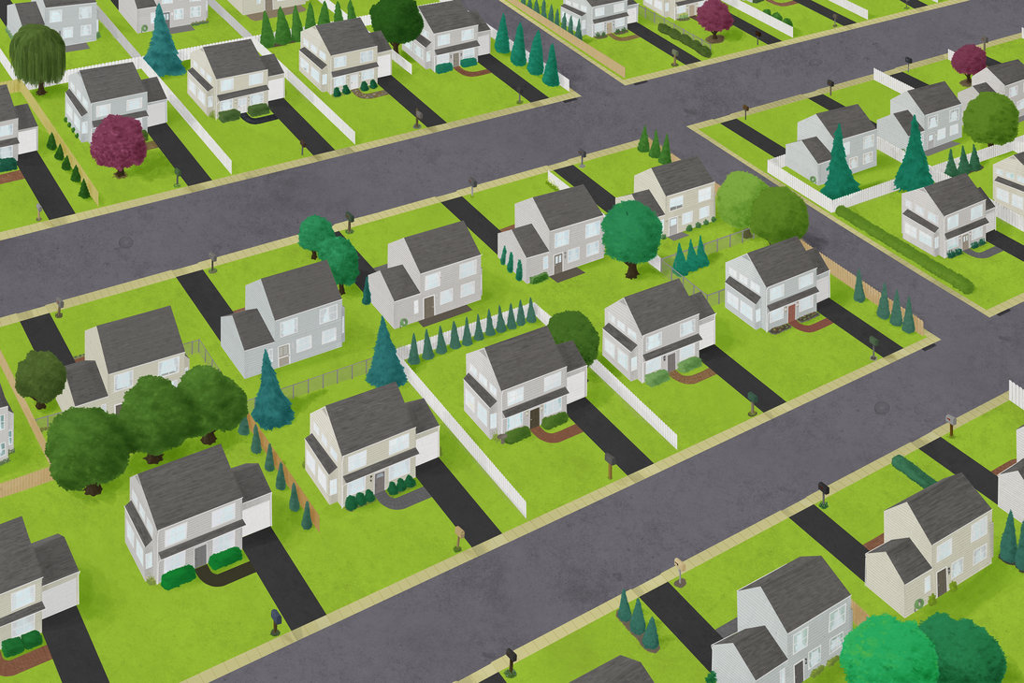
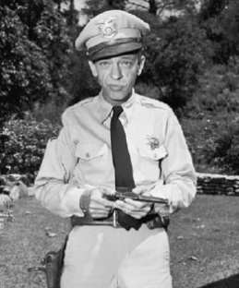

Slide 7
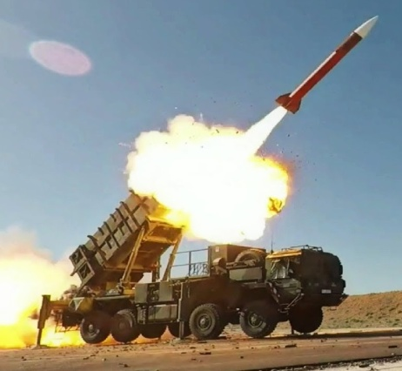

Slide 8
Epistemological Issues in Policing
Police departments are bureaucracies that cannot engage in profit-and-loss calculation.
They have traditionally relied on data they collect incidentally – reported crime, arrests, clearance rates.
Elinor Ostrom and her colleagues engaged in what is probably the best attempt to measure police performance based on community members’ evaluations, but what we can tell from this is limited.

Slide 9
Epistemological Issues in Policing
When policing services are provided through voluntary means, economic calculation is possible.
Individuals can determine whether they receive a “psychic profit” from their security activities or purchases because they can weigh their value of it against alternative uses of their time and money.
Commercial enterprises purchasing security or producing it in-house can measure the monetary costs against the monetary value of the benefit, whether in terms of additional revenue, losses prevented, or higher capital values.

Slide 10
How does a bureaucratic police department make decisions?
The production process primarily consists of responding to calls for service and, when an officer’s time is not otherwise allocated, engaging in vehicular patrol while waiting for calls for service. Investigators will respond to crimes after they occur.
Police bureaucrats do respond to incentives. For example, the allocation of police resources to investigation of drug crime rose in response to civil asset forfeiture becoming more widespread.

Slide 11
Additional Institutional Differences
Government policing primarily takes place in the public domain, which is not privately owned and traded.
Government police are constrained in terms of the rules they can enforce, which must be in accordance with constitutional guidelines regarding due process and civil liberties.

Slide 12
Trade-Offs in Policing
Convenience/dignity and security
Constitutional constraints and security
Whether to use force (or how much)
Officer protections and taxes
Officer accountability and “de-policing”

Slide 13
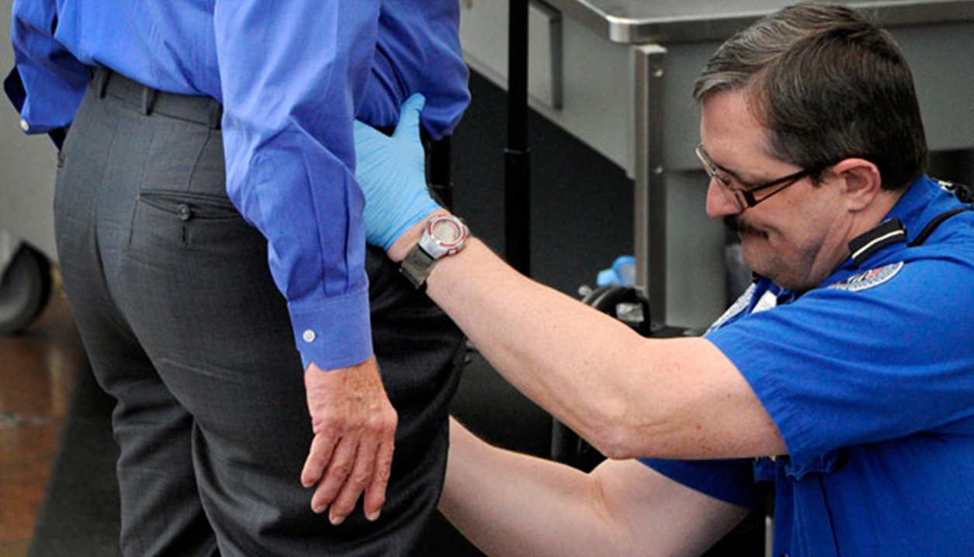

Slide 14
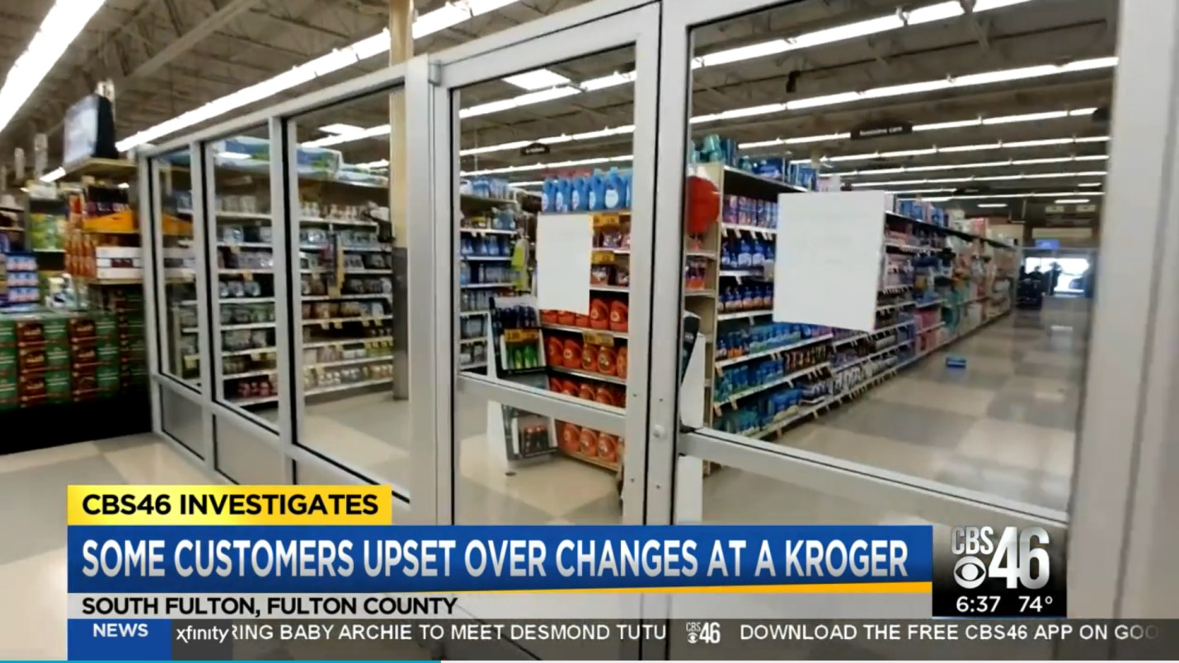

Slide 15
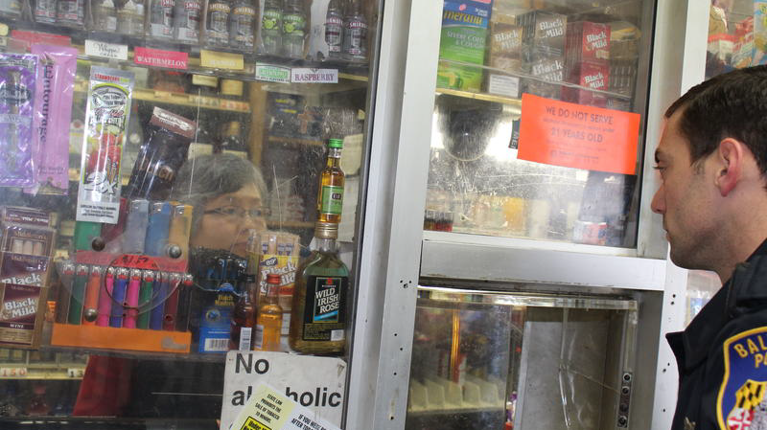

Slide 16
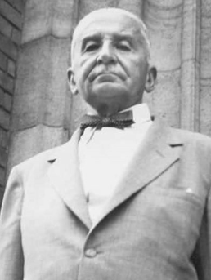
“If one assigns to the authorities the power to imprison or even to kill people, one must restrict and clearly circumscribe this power…The law determines under what conditions the judge should have the right and the duty to sentence and the policeman to fire his gun.”
-Mises, Bureaucracy (p. 37)

Slide 17

The dilemma of vulnerability
“A society that includes extensive public property holdings is therefore faced with what might be called a dilemma of vulnerability. Since governments enjoy privileges denied their citizens and are subject to few of the economic constraints of private institutions, their citizens are forever vulnerable to governmental tyranny.”
-Randy Barnett, The Structure of Liberty

Slide 18
Order Maintenance
Government police are constitutionally constrained in their ability to maintain order in the public domain.
Laws against certain disorderly activities – vagrancy, loitering, panhandling, soliciting, public intoxication – have been voided for vagueness.

Slide 19
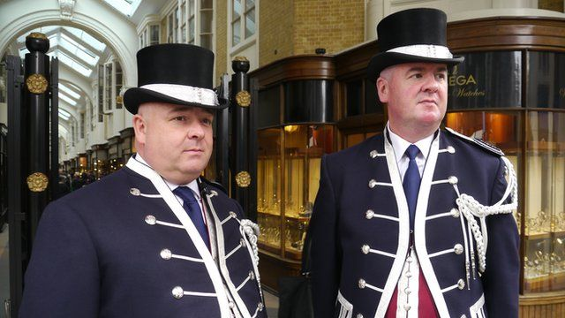
Rule enforcement on private property
Beadles of Burlington Arcade

Slide 20
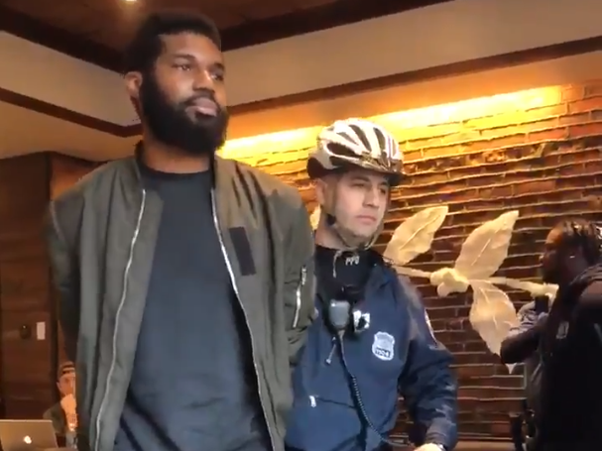
Whether to use force
Use of force is an entrepreneurial decision – sometimes it is profit-maximizing to tolerate a nuisance rather than use force to remove it.

Slide 21
Police Union Protections
Police unions often negotiate for job protections that make punishing police officers more difficult.
All else held constant, more job security will decrease the level of wages that have to be offered.

Slide 22
Trade-off: Lower Taxes vs. Greater Accountability
At least some police unions are willing to negotiate away protections in exchange for higher pay. How much are taxpayers willing to pay for greater accountability?
Political economy issue: service recipients are not homogeneous; the people paying the bulk of the taxes are generally not the ones suffering police misconduct.

Slide 23
Trade-off: Misconduct vs. “De-policing”
A primary justification for protections is that officers will be hesitant to engage in pro-active policing if they don’t have them and public safety will suffer as a result.
Lack of competition keeps such shirking from being punished in the form of lost business.
A firm trying to satisfy consumers wants to find the optimal trade-off between minimizing liability while also protecting clients.

Slide 24
Conclusion
The provision of policing faces many entrepreneurial issues – but bureaucracy is about strictly following rules.
Moving policing outside of the realm of economic calculation contributes to many of the problems we see in policing. The trade-offs inherent in its provision means there are tensions that “reform” (keeping the bureaucracy but changing the rules) cannot resolve.

