Slide 1
Mises University
An Austrian/Libertarian Critique of Covid 19 Vaccine (Mandates)
July 27, 2023
Steve Berger

Slide 2
“It’s very dangerous. A lot of what you’re seeing as attacks on me quite frankly are attacks on science…”
Dr. Anthony Fauci
June, 2021

Slide 3
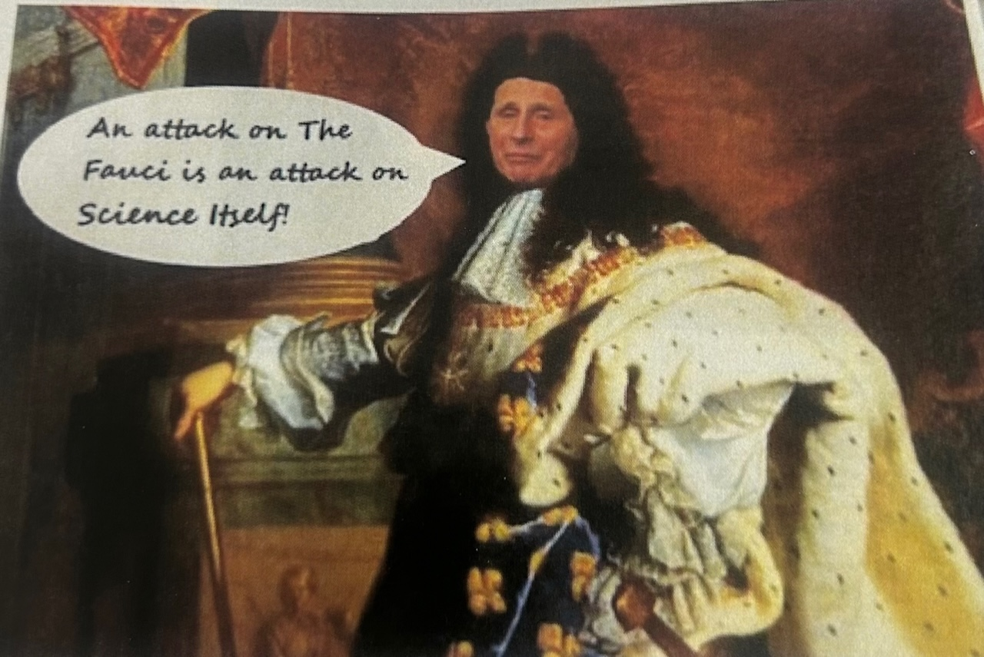

Slide 4


Slide 5
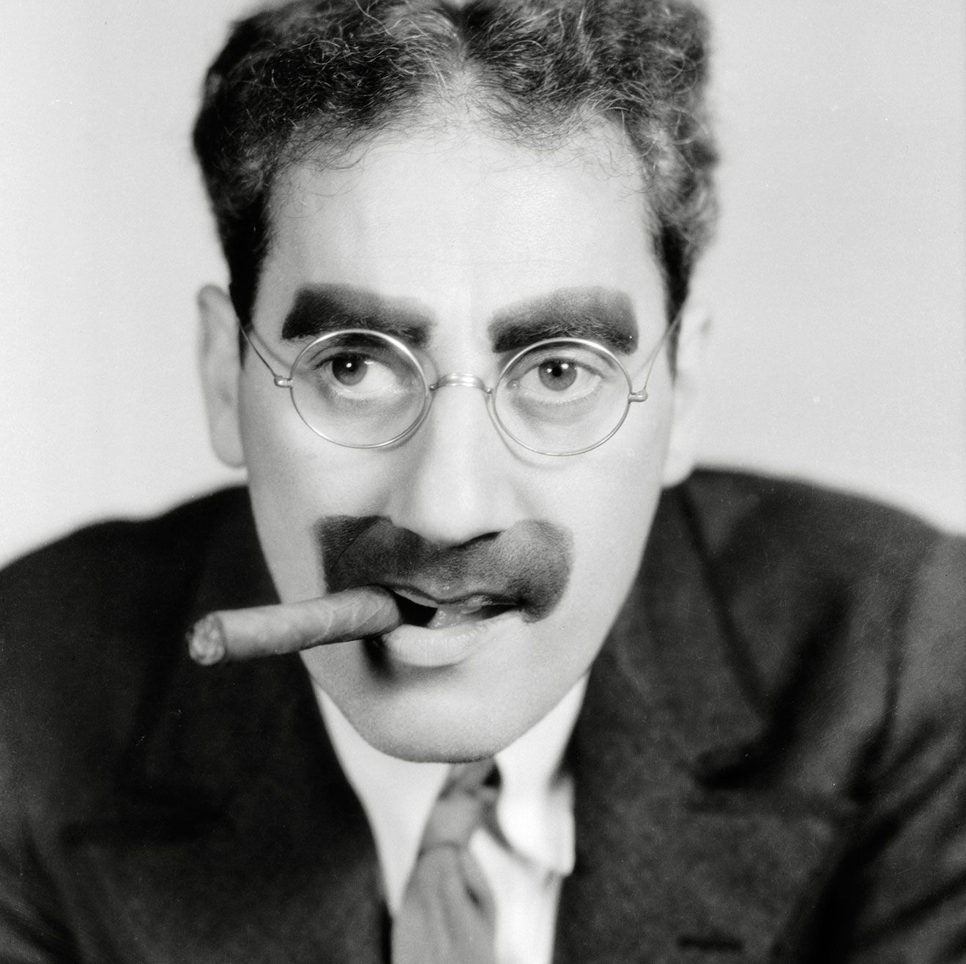
“ Politics is the art of looking for trouble, finding it everywhere, diagnosing it incorrectly and applying the wrong remedies”

Slide 6
Public Health During the Pandemic
A Perfect Batting Average of Incompetence
Lockdowns of the healthy
School closures
Ignoring risk stratifications of Covid deaths/hospitalizations
Social distancing and isolation
  Immune suppression
Masking
Asymptomatic spread: everyone is a vector of transmission
Denial of early treatment and use of repurposed drugs

Slide 7
Public Health During the Pandemic
A Perfect Batting Average of Incompetence Cont…
Deadly hospital protocols (Remdesivir)
Natural immunity is ignored
Vaccinated immunity is broader than natural immunity
Vaccine is safe and effective
Vaccines stop transmission and infection, one and done, and rapidly degrade at the injection site
No informed consent for experimental therapies
GEORGE COSTANZA “DO THE OPPOSITE” WOULD HAVE BEEN A RATIONAL PANDEMIC RESPONSE

Slide 8
The Covid Vaccine Teams
TEAM AUTHORITY
    CDC, FDA, NIH, HHS, DOD
    President Biden
    Big Pharma
    Mainstream Media
    Colleges and Universities
    Medical Associations
    Gates Foundation and other NGOs
    Most state governors and assorted world tyrants (Trudeau, Jacinda Ardern)

Slide 9
The Covid Vaccine Teams cont…
TEAM DISSENT
  Esteemed, not “fringe” epidemiologists from Harvard, Stanford, and Oxford (authors of the GBD)
  Independent or brave physicians in the field (Drs. McCullough, Risch, Zelenko, Kory, Marik, Fareed & Tyson, Malhotra)
  RFK Jr. and the Disinformation Dozen
  Medical ethicists like Dr. Aaron Kheriaty
  Censored journalists (Berenson, Wolf)
  Vaccine injured - React 19
  No College Mandates, Freedom Health Defense Fund, VSRF

Slide 10
COVID TEAM AUTHORITY
“You’re not going to get Covid if you got these vaccinations…We are in a pandemic of the unvaccinated” -Joe Biden
“The vaccines are safe and effective” -Anthony Fauci
“Our data from the CDC today suggests that vaccinated people do not carry the virus, do not get sick – and it’s not just in the clinical trials but it’s also in real-world data.”-Rochelle Walensky
“God did answer our prayers. He made the smartest men and women, the scientists, the doctors, the researchers, he made them come up with a vaccine that is from God to us.” – New York Governor Kathy Hochul
“ I really think this is why God gave us two arms, one for the flu shot and the other for the Covid shot.”– Dr. Anish Jha, Biden White House Covid Coordinator, Dean of the School of Public Health, Brown University

Slide 11
Hmm…Safe, Free, Effective and Necessary??
“If you repeat a lie often enough, people will believe it, and you will even come to believe it yourself.” -Joseph Goebbels
“The most dangerous man to any government is the man who is able to think things out for himself, without regard to the prevailing superstitions and taboos. Almost inevitably he comes to the conclusion that the government he lives under is dishonest, insane and intolerable.” – HL Mencken

Slide 12
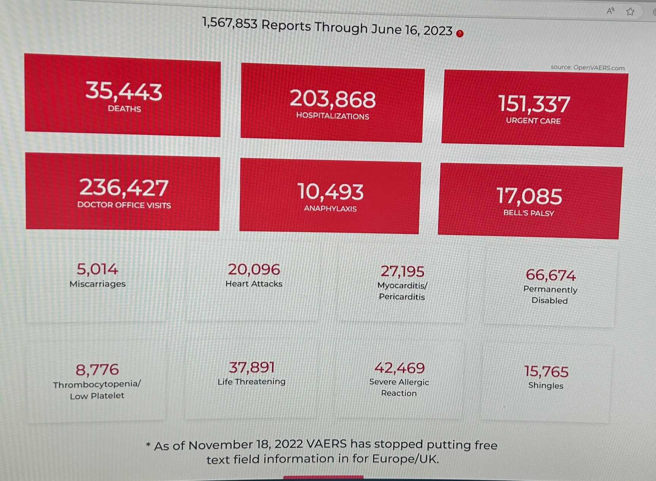
VAERS COVID VACCINE ADVERSE EVENT REPORTS
Source: openvaers.com

Slide 13
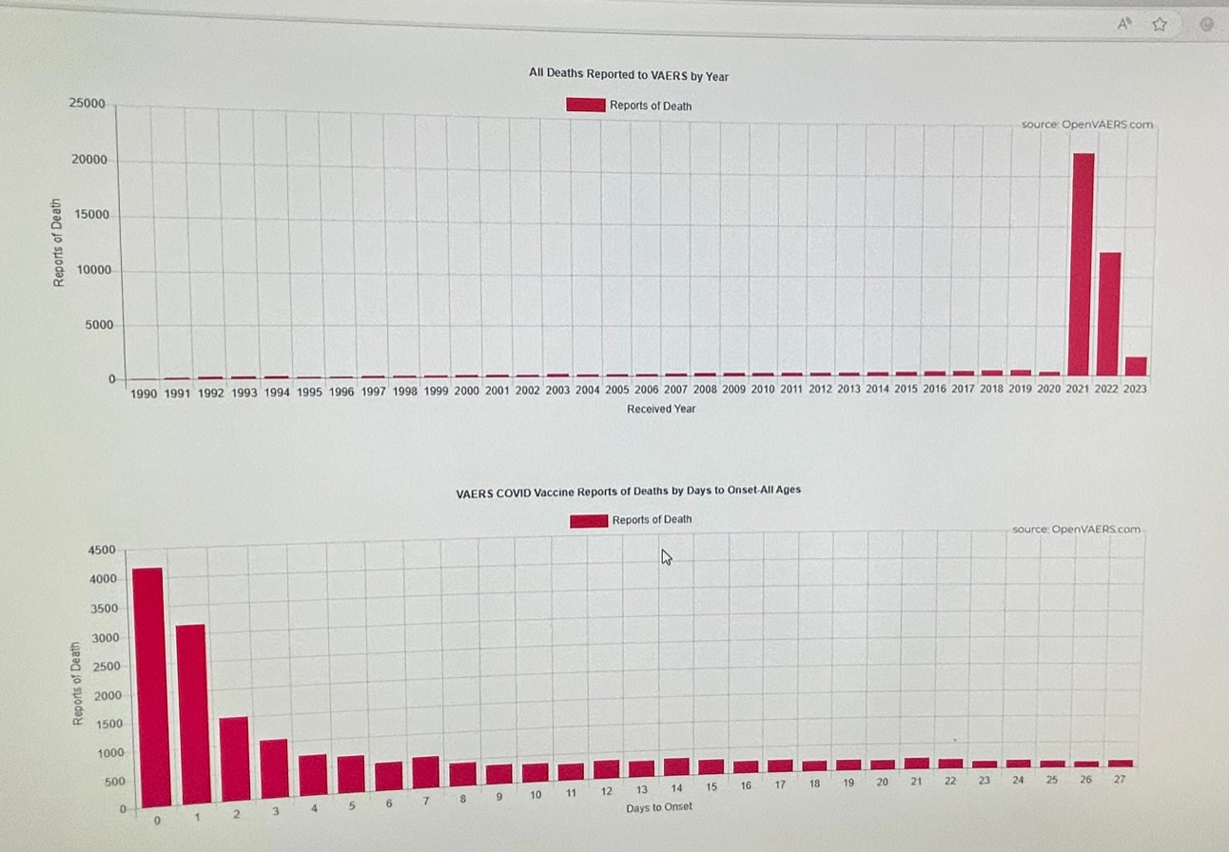
VAERS COVID VACCINE ADVERSE EVENT REPORTS
openvaers.com

Slide 14
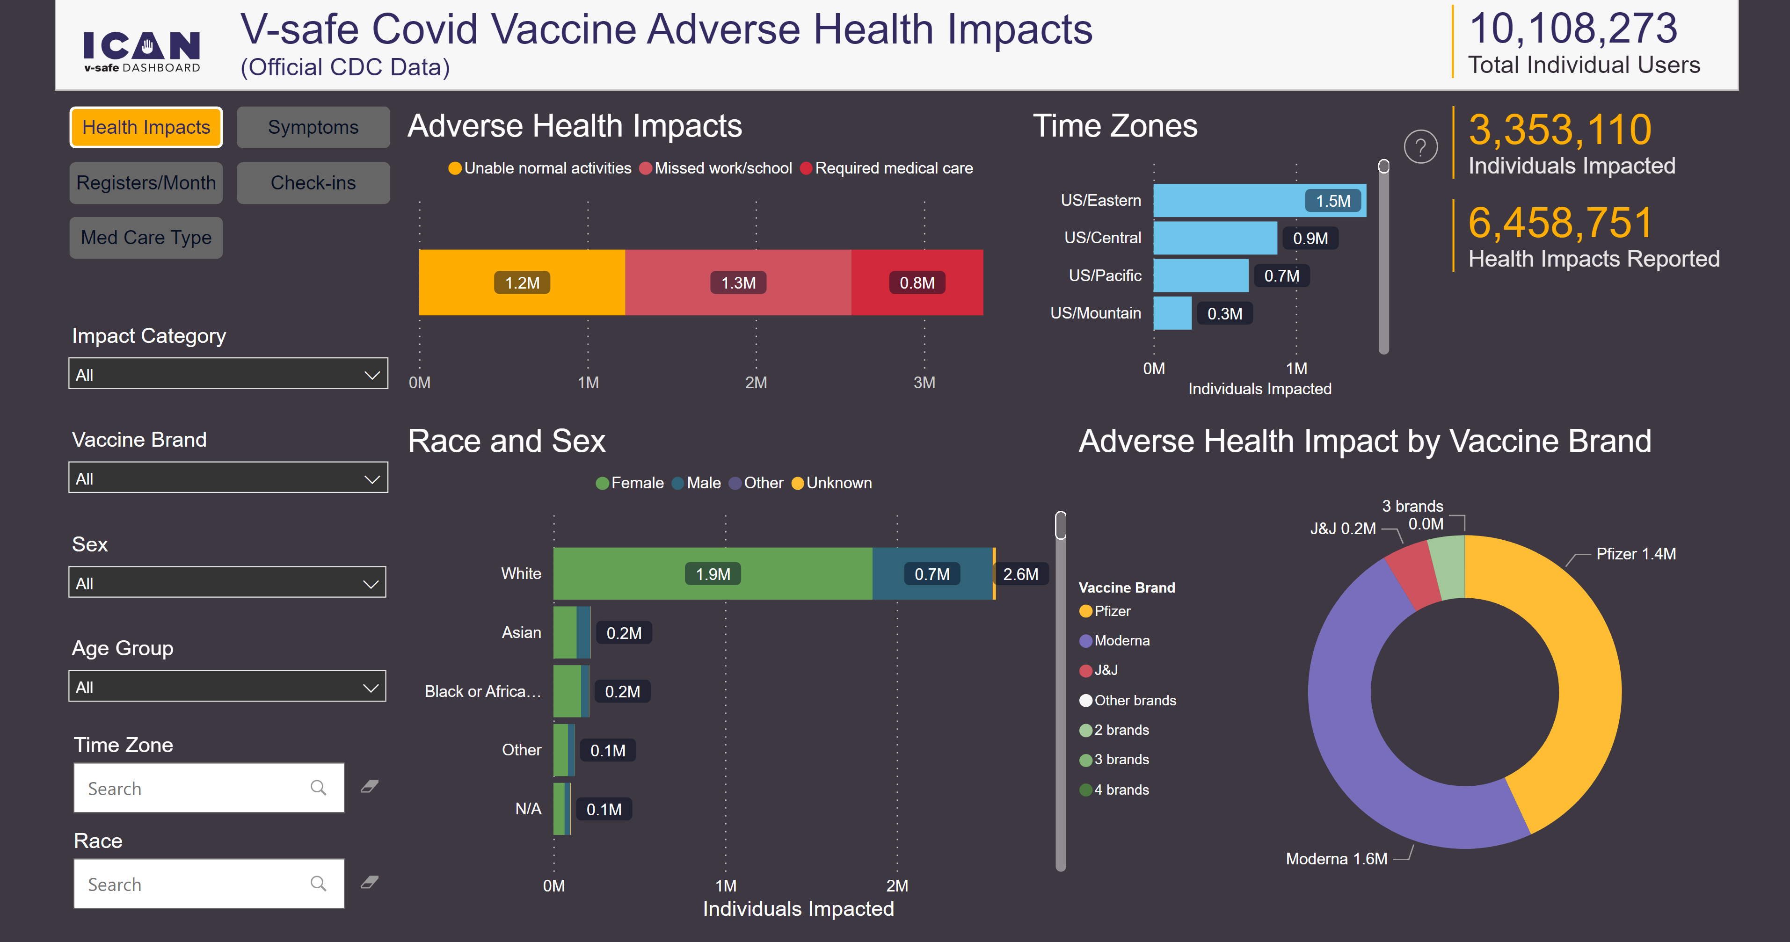

REGULATORS: CDC
7.7% Needed Medical Care
(4.2% in First 6 Weeks)
(3 in 4 were hospitalized or needed emergency room or urgent care)
32% Missed School/Work or Unable to Perform Normal Daily Activities
https://icandecide.org/v-safe-data/
Source: Aaron Siri presentation to the Arizona State Senate, June 2023

Slide 15
Source: Kevin Duffy, Bearing Asset

Slide 16
An Alternative Way to Solve the Covid Vaccine Debate – Austrian Economic Theory
Key Concepts:
Monopoly power is a state construct providing artificial protection to favored corporations
  High price/low quality inevitable
  Disincentive to improve and respond to changing consumer preferences
Free market process vs centralized planning
  Price information
  Market feedback to improve quality and/or lower prices vs. regulatory inertia
  Blowback from losses and bankruptcy; regulatory failure either denied or rewarded with increased budgets
  Continuous process of innovation and discovery driven by competition or threat of competition
“Mixed” systems (corporatism) beget more intervention, regulatory capture and rigidity
A libertarian law order – to protect private property exchanges from force/fraud

Slide 17
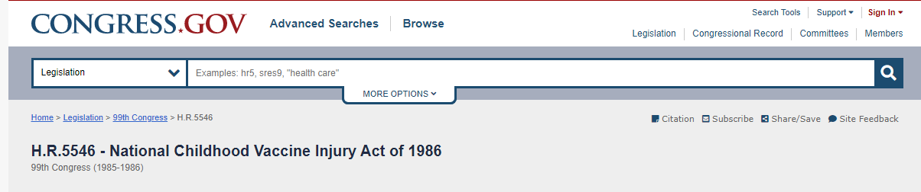
Market forces eliminated
42 U.S.C. 300aa-11 (“No person may bring a civil action for damages … against a vaccine administrator or manufacturer … for damages arising from a vaccine-related injury or death associated with the administration of a vaccine”)
Bruesewitz v. Wyeth, 562 U.S. 223 (“[W]e hold that the National Childhood Vaccine Injury Act pre-empts all design-defect claims against vaccine manufacturers brought by plaintiffs who seek compensation for injury or death caused by a vaccine side effects.”)
NO OTHER CONSUMER PRODUCT ENJOYS THIS DEGREE OF IMMUNITY
Source: Aaron Siri presentation to the Arizona State Senate, June 2023

Slide 18
Market forces eliminated
Guaranteed Market + No Liability =
1986
2023
DTP (2 months)
OPV (2 months)
DTP (4 months)
OPV (4 months)
DTP (6 months)
MMR (15 months)
DTP (18 months)
OPV (18 months)
DTP (4 years)
OPV (4 years)
T (14 years)
Hepatitis B (one day)
Hepatitis B (one month)
DTaP (2 months)
IPV (2 months)
Hib (2 months)
PCV (2 months)
Rotavirus (2 months)
DTaP (4 months)
IPV (4 months)
Hib (4 months)
PCV (4 months) Rotavirus (4 months)
DTaP (6 months)
IPV (6 months)
Hepatitis B (6 months)
Hib (6 months)
PCV (6 months)
Covid-19 (6 months)
Rotavirus (6 months)
Influenza (6 months)
Covid-19 (8 months)
MMR (12 months)
Varicella (12 months)
Hib (12 months)
Hepatitis A (12 months)
PCV (12 months)
Covid-19 (12 months)
DTaP (15 months)
Hepatitis A (18 months)
Influenza (18 months)
Influenza (2 years)
Influenza (3 years)
Influenza (4 years)
DTaP (4 years)
MMR (4 years)
IPV (4 years)
Varicella (4 years)
Influenza (5 years)
Influenza (6 years)
Influenza (7 years)
Influenza (8 years)
Influenza (9 years)
Influenza (10 years)
HPV (11 years)
Men ACWY (11 years)
Influenza (11 years)
Tdap (11 years)
HPV (11 ½ years)
Influenza (12 years)
Influenza (13 years)
Influenza (14 years)
Influenza (15 years)
Men ACWY (16 years)
Influenza (16 years)
Influenza (17 years)
Source: Aaron Siri presentation to the Arizona State Senate, June 2023
1983 CDC Vaccine Schedule: https://www.cdc.gov/vaccines/schedules/images/schedule1983s.jpg
2023 CDC Vaccine Schedule: https://www.cdc.gov/vaccines/schedules/downloads/child/0-18yrs-child-combined-schedule.pdf

Slide 19
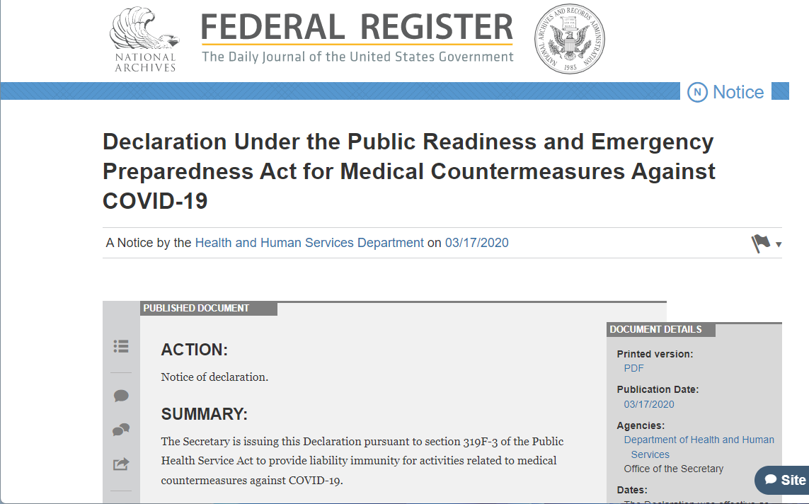
MARKET FORCES: Covid-19 vaccines
Eliminated for Covid-19 Vaccines
+
Source: Aaron Siri presentation to the Arizona State Senate, June 2023
42 U.S.C. § 247d-6d
Complete immunity: “[M]anufacturers” of “any vaccine, used to treat, … prevent or mitigate COVID-19” shall enjoy “[l]iablity immunity ,” including, “from suit and liability under Federal and State law with respect to all claims for loss caused by, arising out of, relating to, or resulting from the administration to or the use by an individual of a [COVID-19 vaccine].”
Except creates a single count for “willful misconduct”
But, for “a manufacturer or distributor” an “act or omission shall not constitute ‘willful misconduct’ … if—(i) neither the Secretary nor the Attorney General has initiated an enforcement action with respect to such act or omission; or (ii) such an enforcement action has been initiated and the action has been terminated or finally resolved without a covered remedy.”

Slide 20
The Covid Vaccine Cartel – Operation Warp(ed) Speed
Most corrupt, large-scale monopoly ever?
  Almost $75 billion in Covid vaccine revenue to Pfizer for 2021-22 period
  Share the spoils: $400 million royalty settlement with Moderna awarded to NIH, Scripps and Dartmouth (Go Green!) College
  Billions to doctors, insurers, hospitals, media, colleges and universities to promote vaccines and mandates
  How can agencies profiting from and promoting shots be expected to monitor manufacturing quality and safety issues?
Complete liability shield under PREP Act for EUA products – no legal and (apparently) no vaccine immunity
EUA language established financial incentive to “sandbag” any competing, potentially effective therapies/drugs
Massive censorship campaign (Twitter, other social media) to suppress early treatment meds and gaslight vaccine injuries
Disincentive to examine injury signals
From carrots to vaccine mandates (if the shots are so effective, why are bribes necessary?; if so safe, why is there a liability shield?)

Slide 21
Free Market Alternative
Get the State out of Healthcare
Vaccines compete with therapeutics, neutraceuticals and other mechanisms of protection
Consumer sovereignty – preferences for safety/efficacy based on bottom-up risk/benefit assessment
Certification businesses will emerge; safety is a private good.
Industry best practices set through voluntary agreements and/or insurers
Physician/patient relationship restored and privacy respected
Mandates highly unlikely in a free market/libertarian legal order.
No pharma lobbying if state is separated from healthcare; the politicization and polarization we saw during Covid evaporates.
Liability for fraud/injury enhances manufacturing safety
If vaccines are too expensive to produce safely, do we really care?

Slide 22
Why Does This All of This Matter?
“Of all tyrannies, a tyranny sincerely exercised for the good of its victims may be the most oppressive. It would be better to live under robber barons than under omnipotent moral busybodies. The robber baron's cruelty may sometimes sleep, his cupidity may at some point be satiated; but those who torment us for our own good will torment us without end for they do so with the approval of their own conscience. They may be more likely to go to Heaven yet at the same time likelier to make a Hell of earth. This very kindness stings with intolerable insult. To be "cured" against one's will and cured of states which we may not regard as disease is to be put on a level of those who have not yet reached the age of reason or those who never will; to be classed with infants, imbeciles, and domestic animals.”
― C.S. Lewis, God in the Dock: Essays on Theology (Making of Modern Theology)

