Slide 1
Understanding
Money Mechanics
Robert P. Murphy
Mises Institute, Orlando
May 2022

Slide 2
Outline
A) Inflation
B) Recession coming?
C) Yield Curve Inversion
D) Putin's Moves to Strengthen Ruble

Slide 3
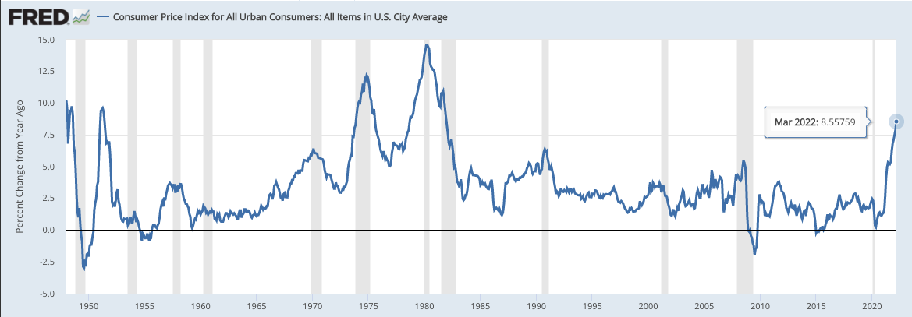
Consumer Price Inflation

Slide 4
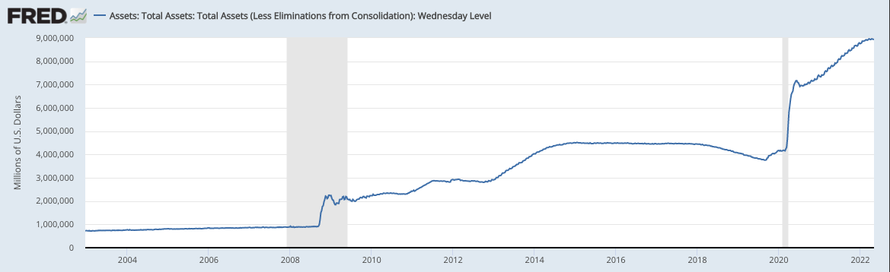
Assets on the Fed's Balance Sheet
QE 3
Covid-19
QE 2
QE 1

Slide 5
Why Didn't (Consumer Price) Inflation
Hit Earlier, After Rounds of
(Unprecedented) QE?

Slide 6
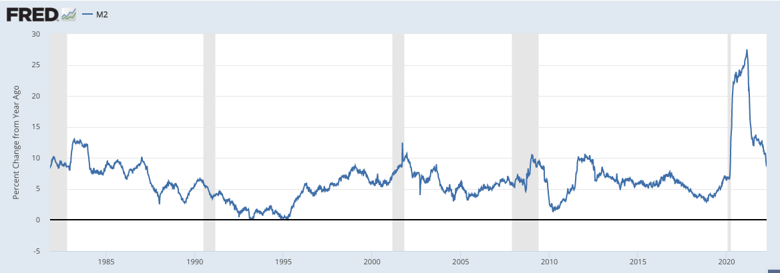
Growth in M2: This Time Was Different

Slide 7
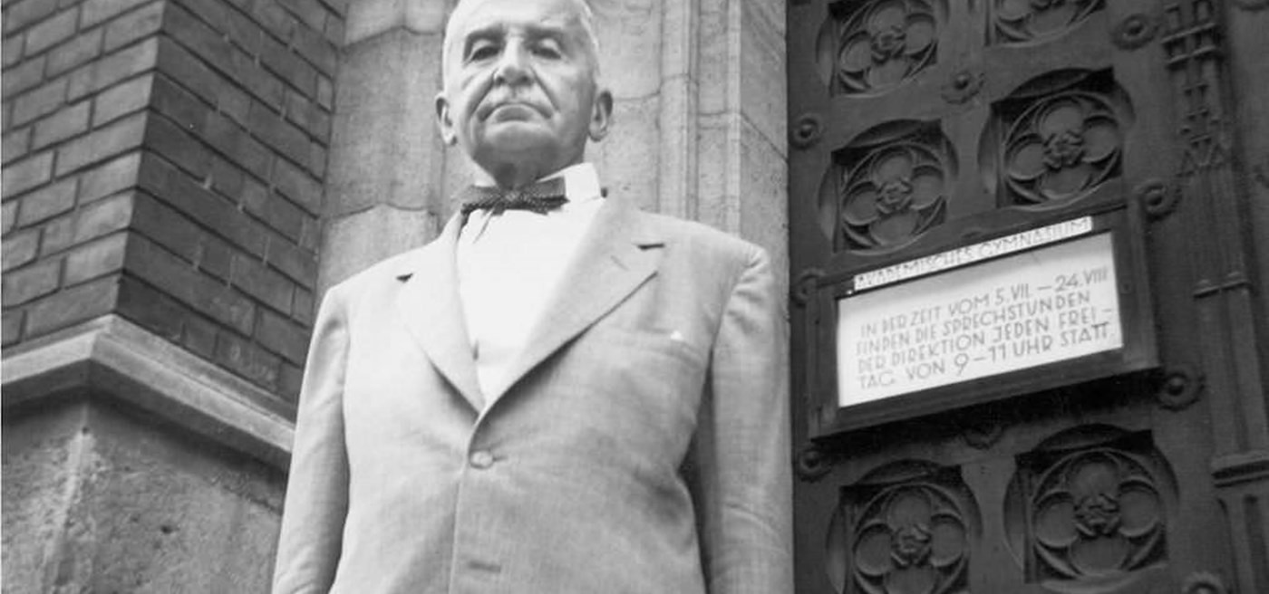
Austrian Business Cycle Theory
➔ Banking system (esp. central bank) floods market with unbacked credit.
➔ Interest rates pushed down to artificial lows.
➔ Creates temporary “boom” period, built on illusion.
➔ Banks ultimately relent, rates rise, crash ensues.

Slide 8
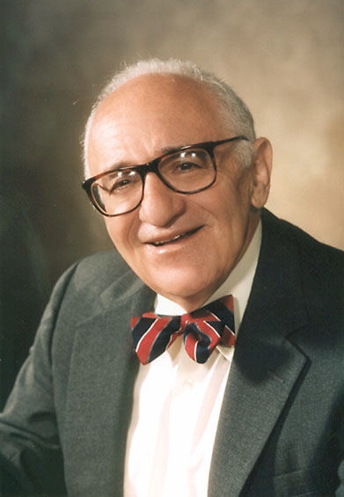
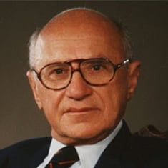
Austrians vs. Chicago School on Great Depression

Slide 9
So Fed hasn't started selling assets, and M2 growth still high.
But what about yield curve—
Did it recently invert? Isn't the Fed tightening by raising interest rates?

Slide 10
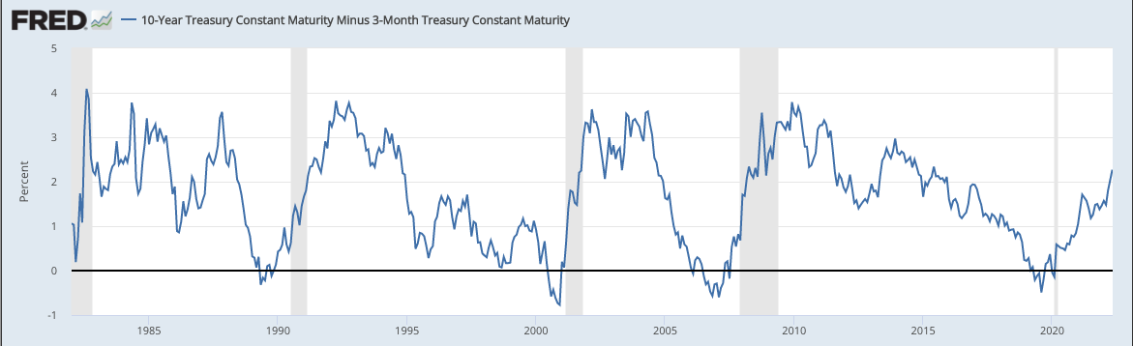
Inverted Yield Curve "Predicts" Recession
Wrong way for Fed tightening

Slide 11
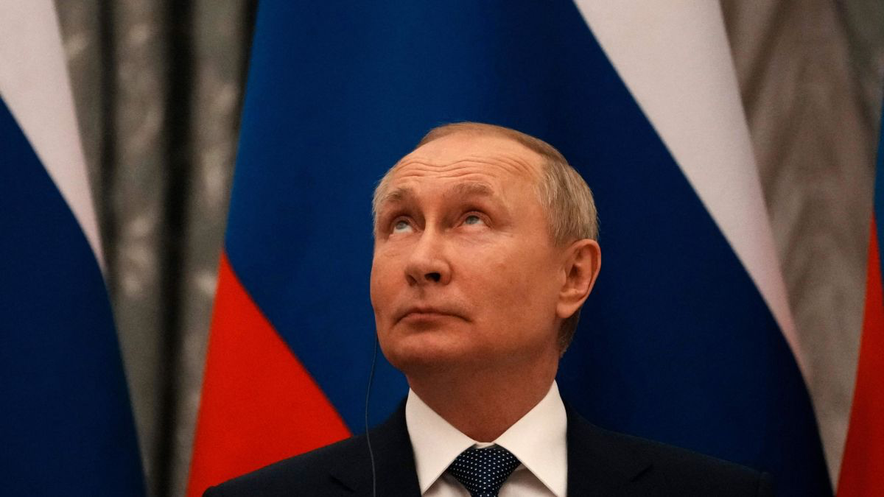
Did Russia link ruble to gold?
Insist oil & gas payments in rubles?

